Slide 1
Carbohydrate Fermentation Results of Unknowns 370LW - Fall 2020
200930

Slide 2
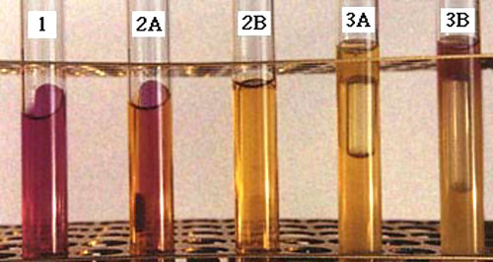
Possible Results for Carbohydrate Fermentation Tubes
Tube 1: No fermentation. The pH indicator remains red. There can still be growth due to the use of amino acids as sources of energy (usually by respiration).
Tubes 2A and 2B: Fermentation with the production of acid (yellow color) but no gas. A slight amount of acid is seen in tube 2A, but fermentation is still recorded for this tube.
Tubes 3A and 3B: Fermentation with the production of acid (yellow color) and insoluble gas (bubble in Durham tube). Tube 3B shows an alkaline reaction on top; this is simply due to deamination of amino acids whose alkaline reaction has not been over-neutralized by the acid diffusing through the tube from fermentation.
Put Results in a Table – Score w 1-3 +s Columns for Acid and Gas

Slide 3
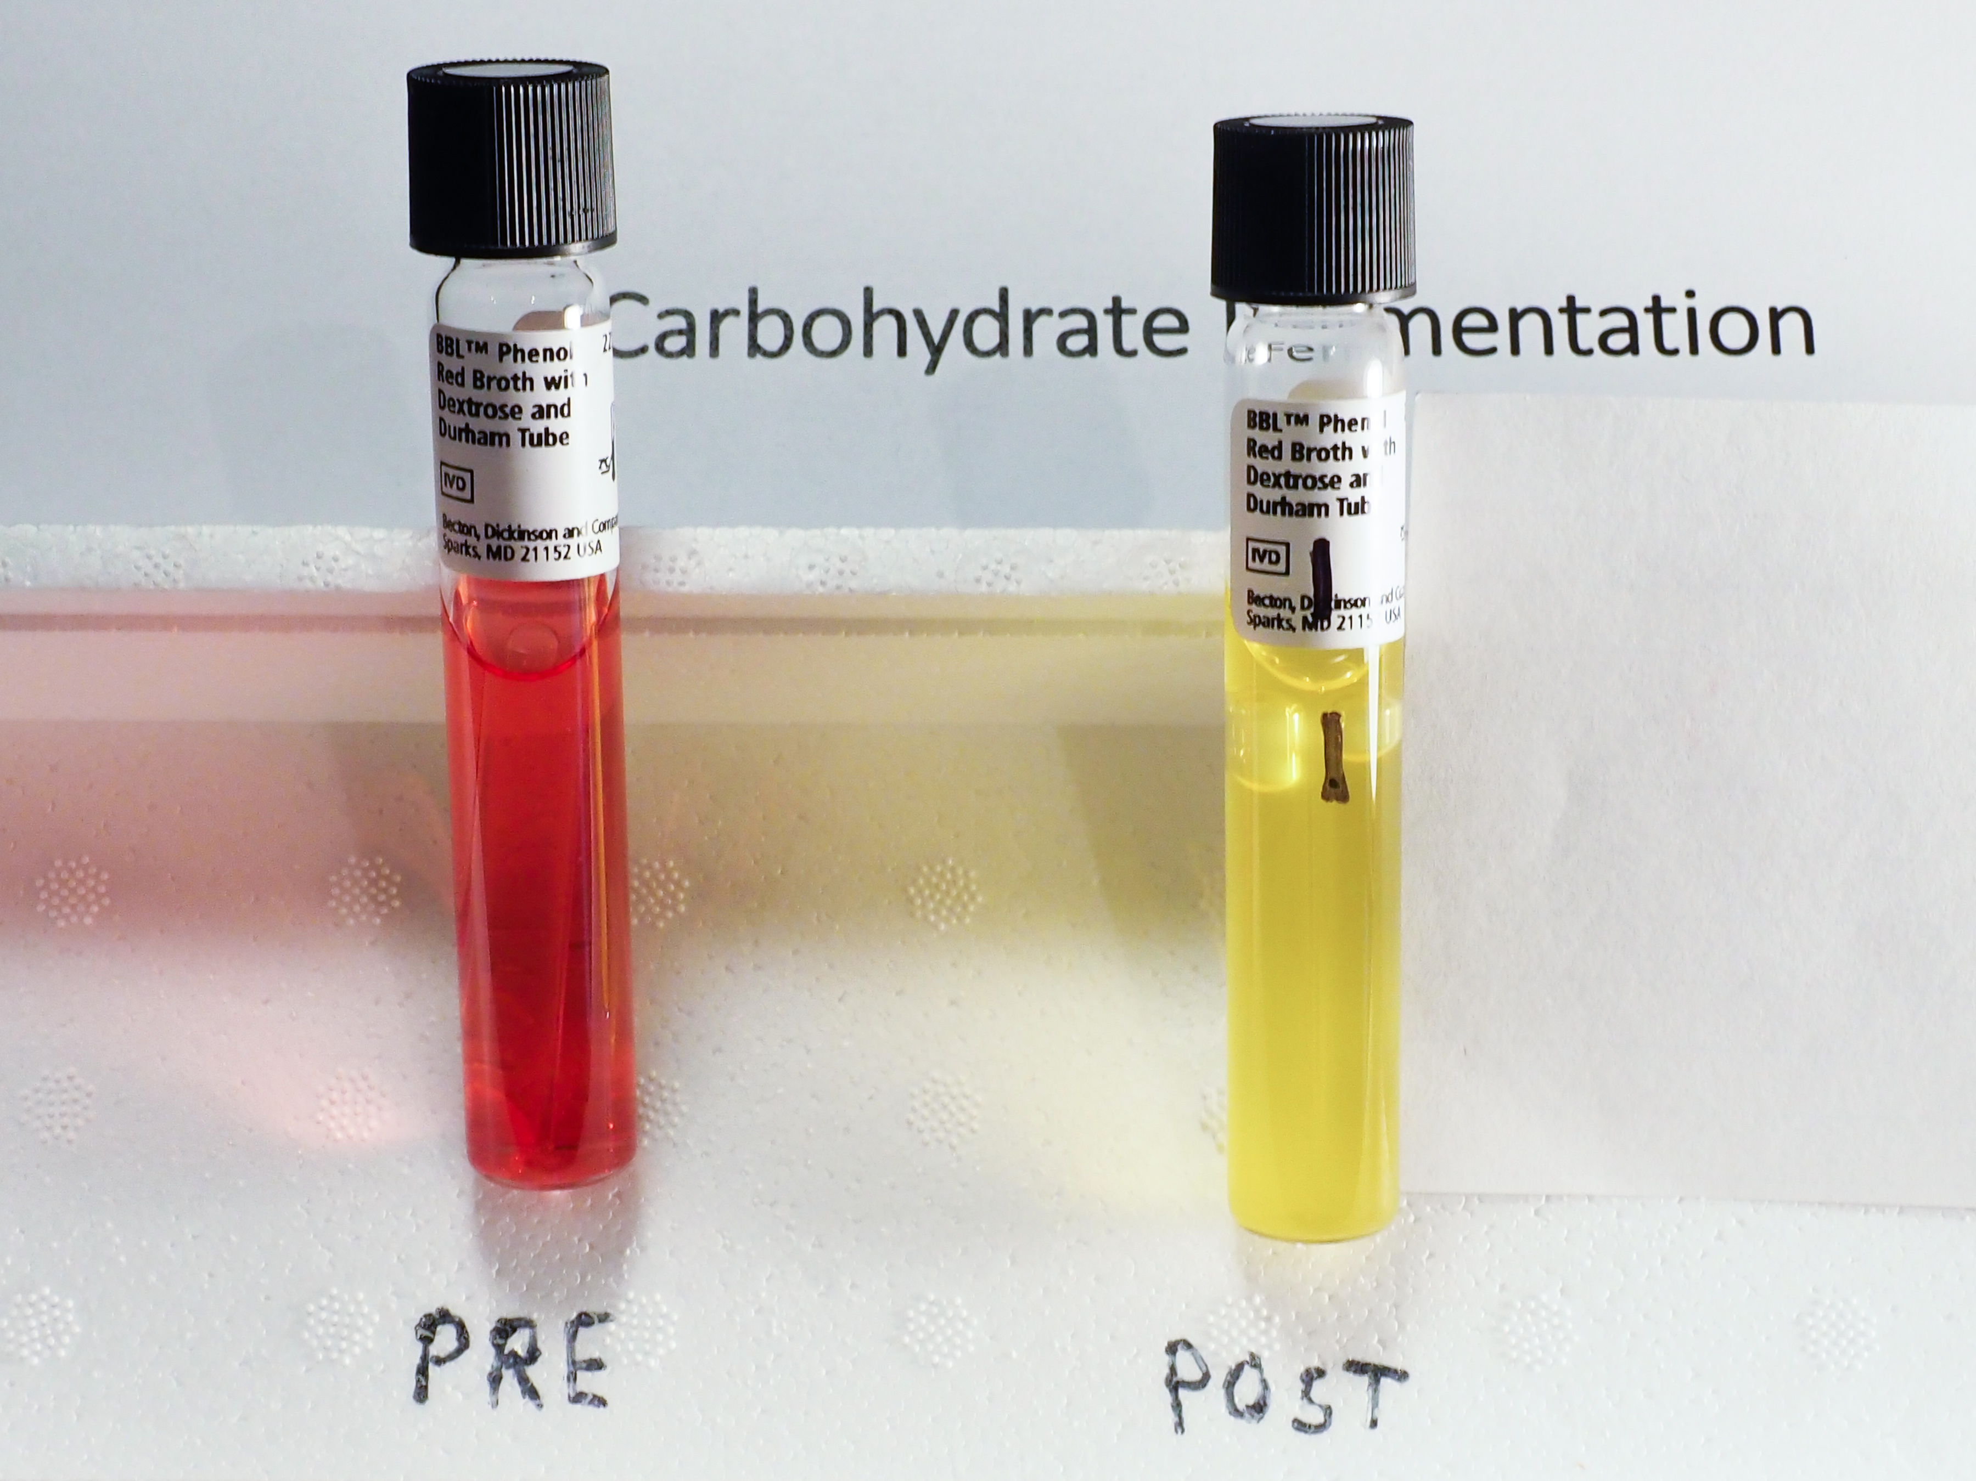
Unknown #1

Slide 4
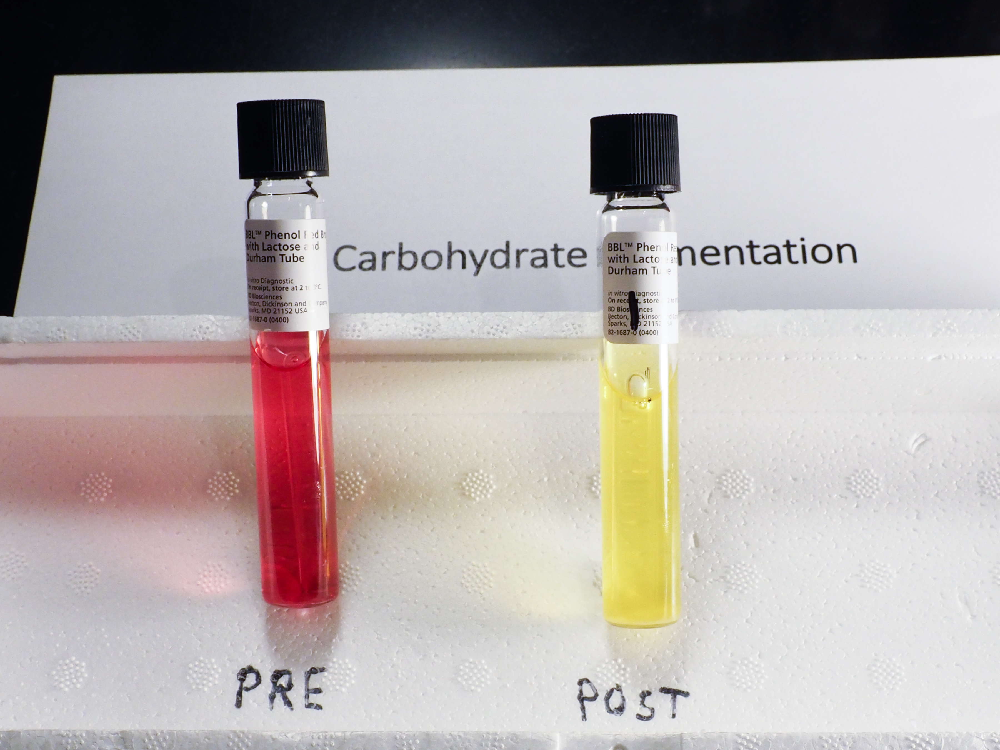
Unknown #1

Slide 5
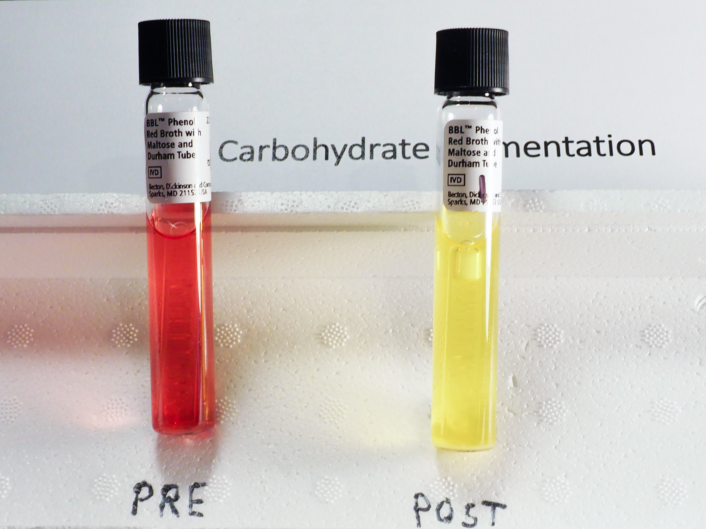
Unknown #1

Slide 6
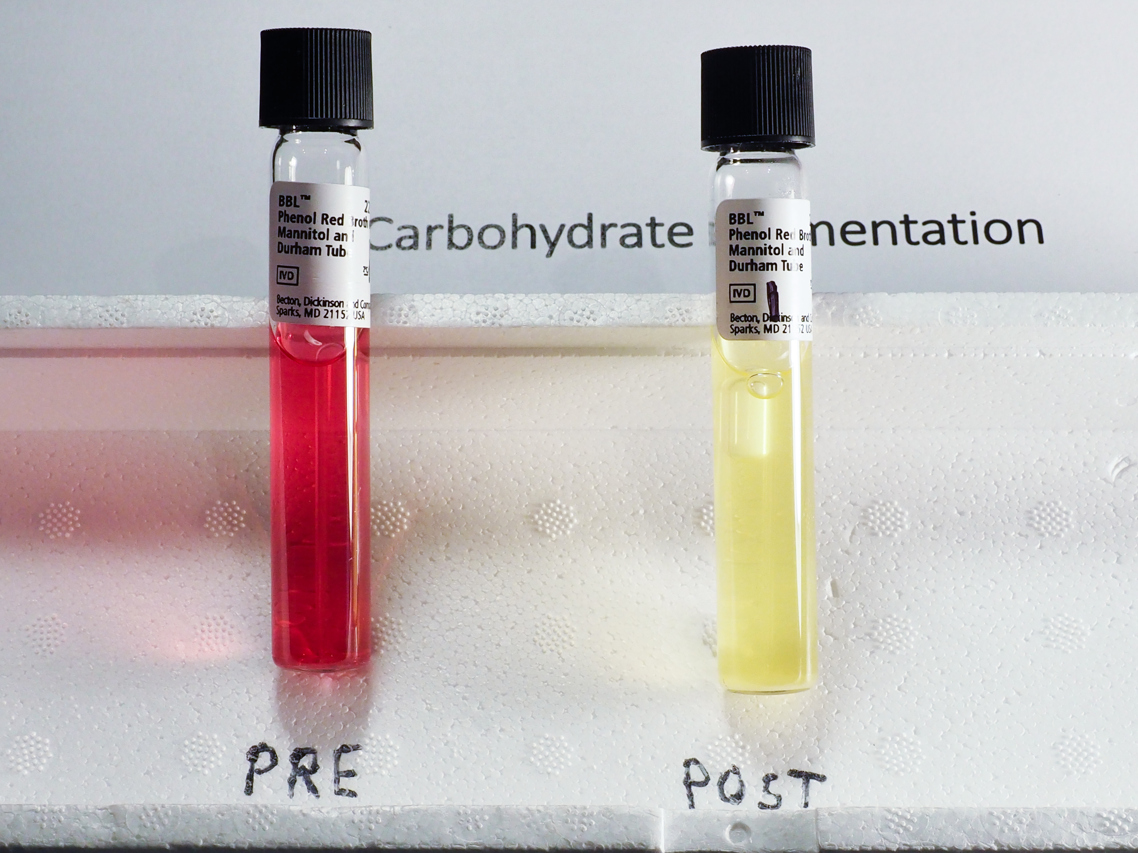
Unknown #1

Slide 7
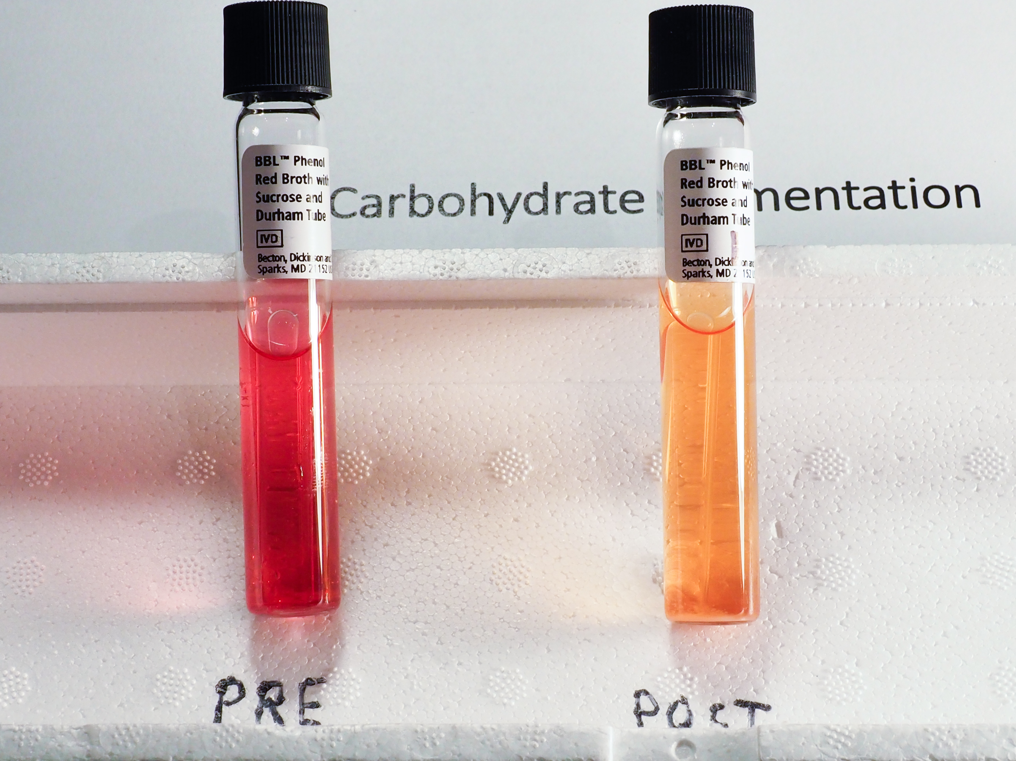
Unknown #1

Slide 8
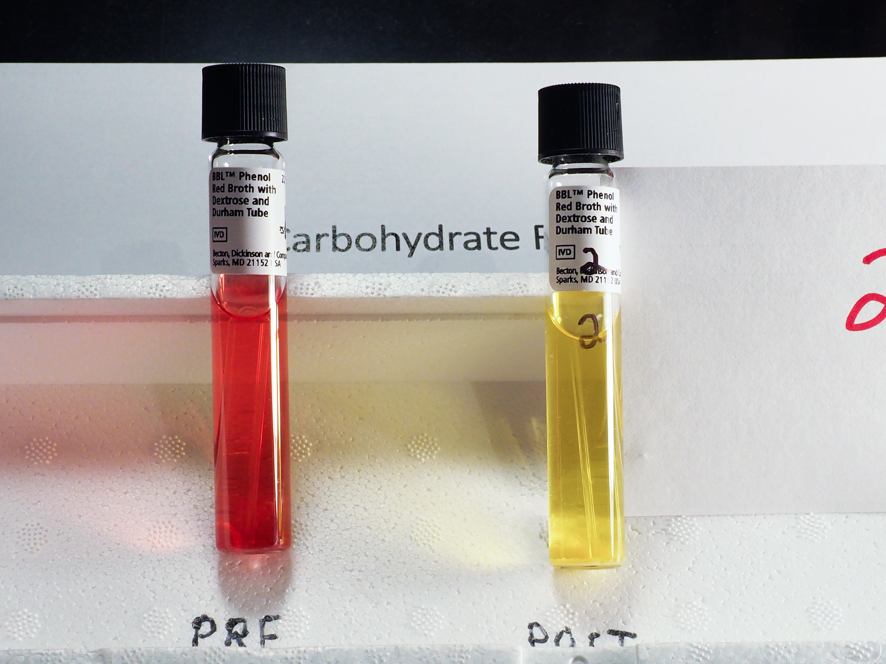
Unknown #2

Slide 9
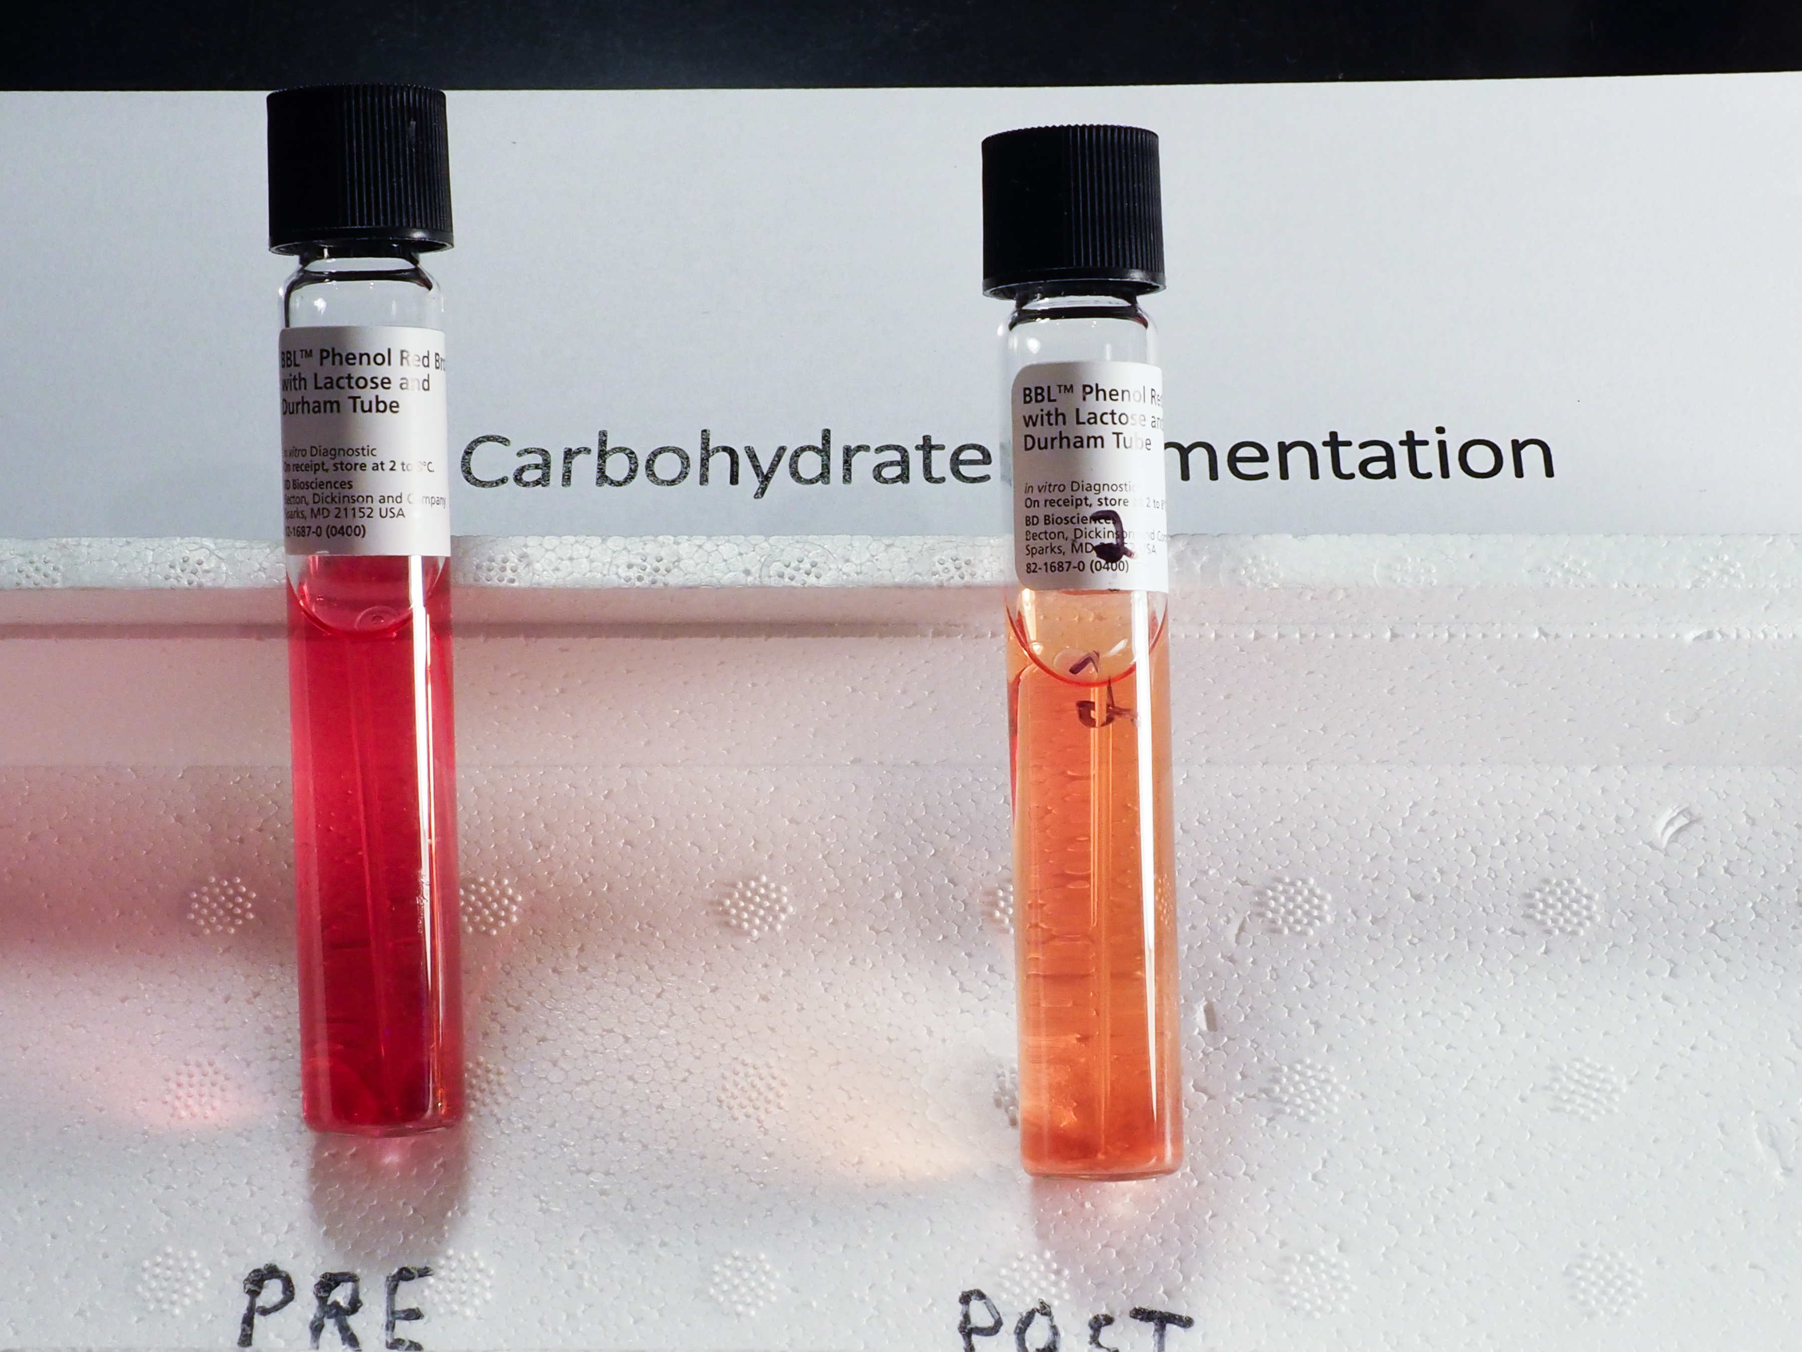
Unknown #2

Slide 10
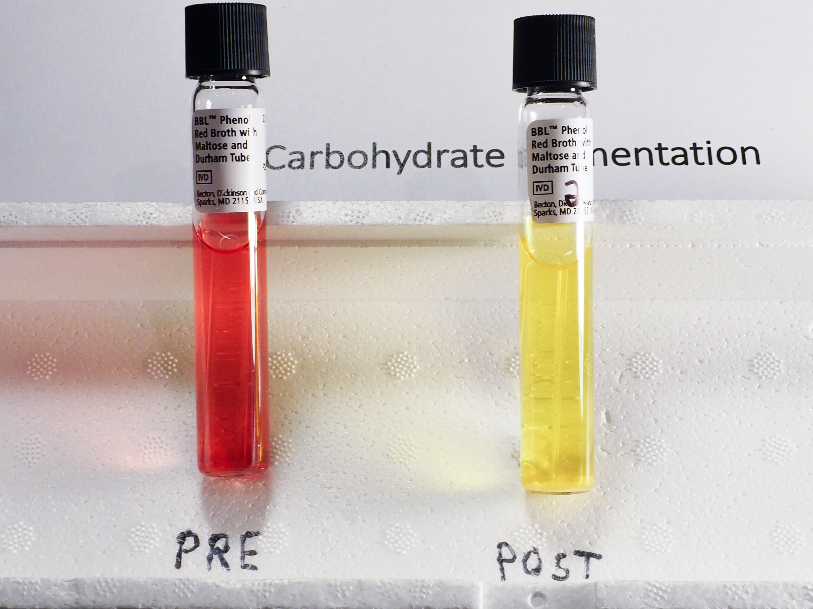
Unknown #2

Slide 11
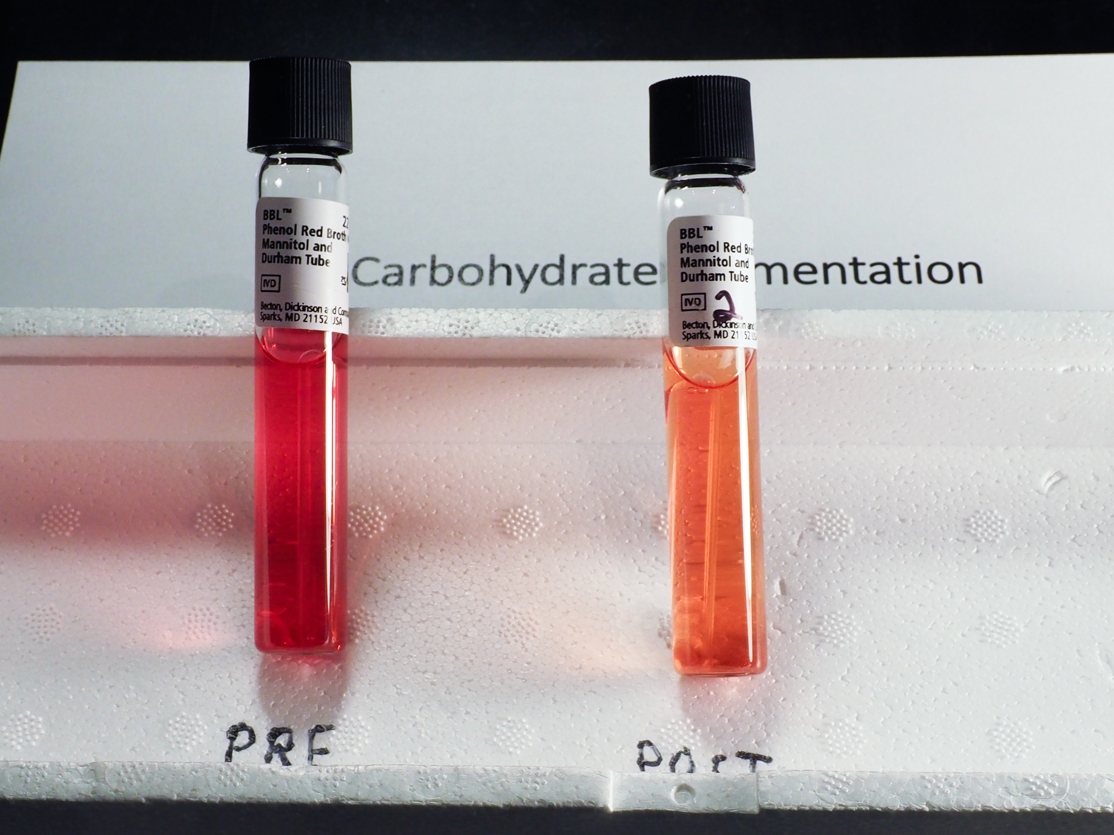
Unknown #2

Slide 12
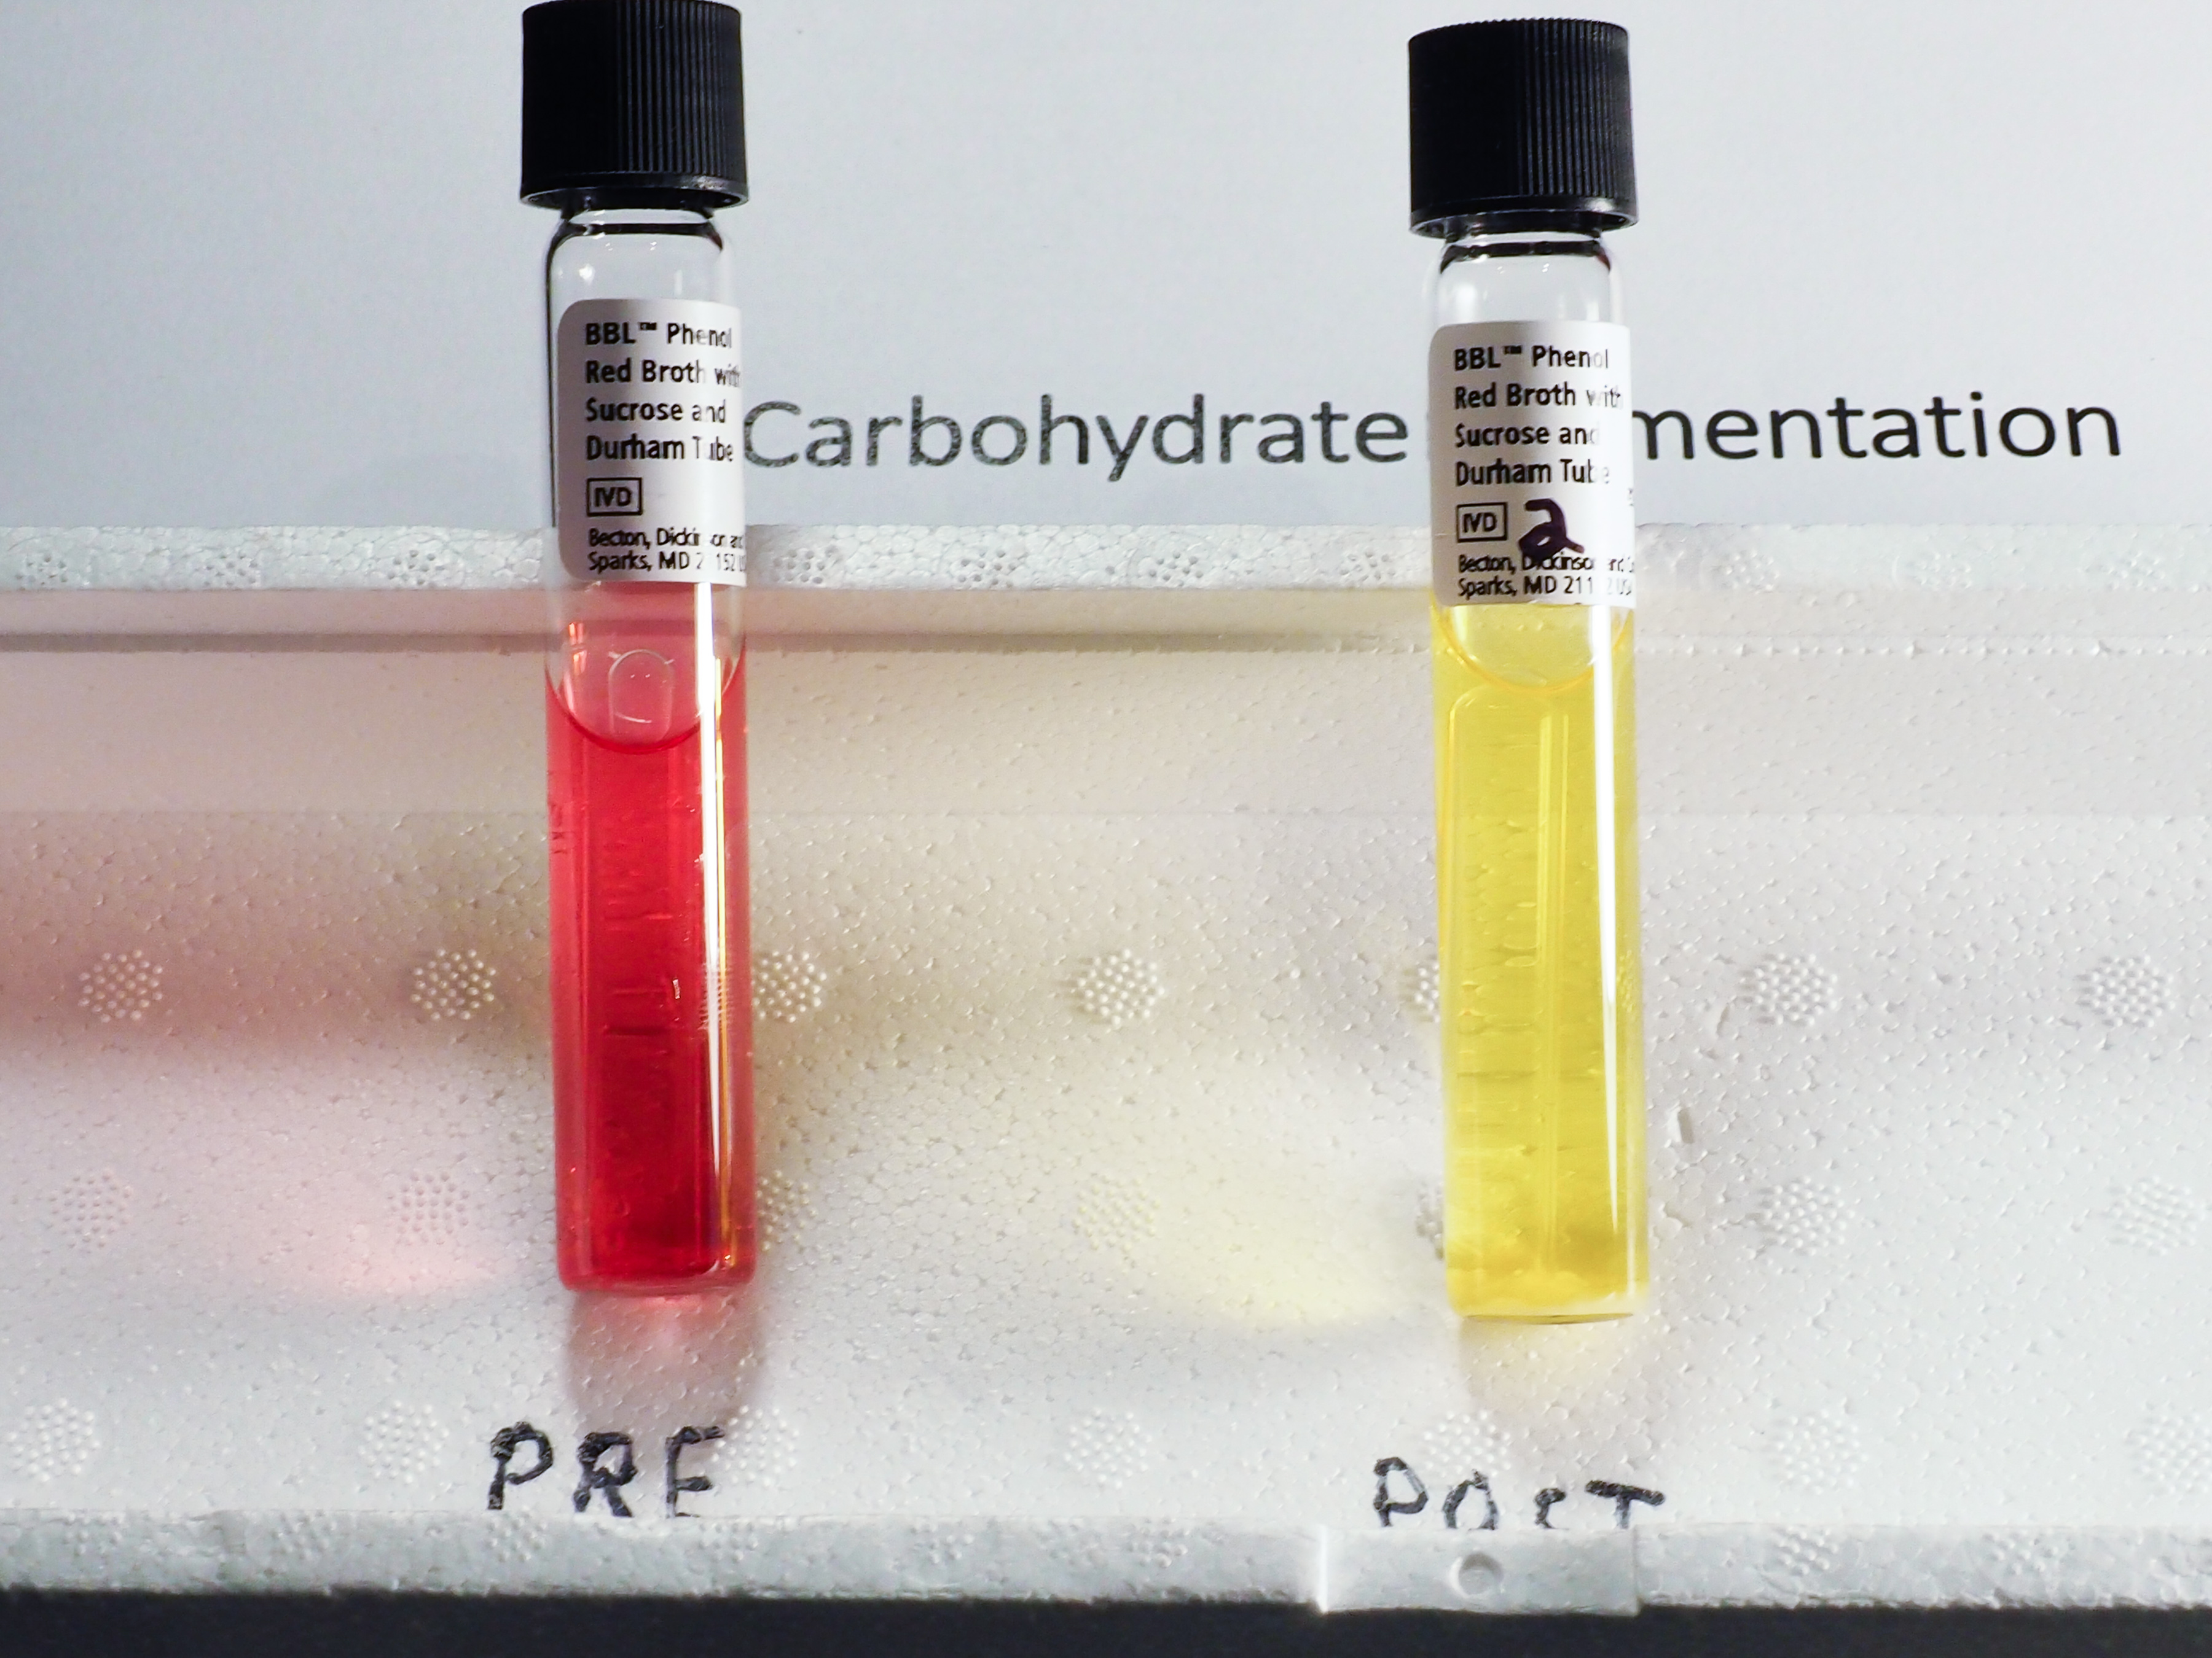
Unknown #2

Slide 13
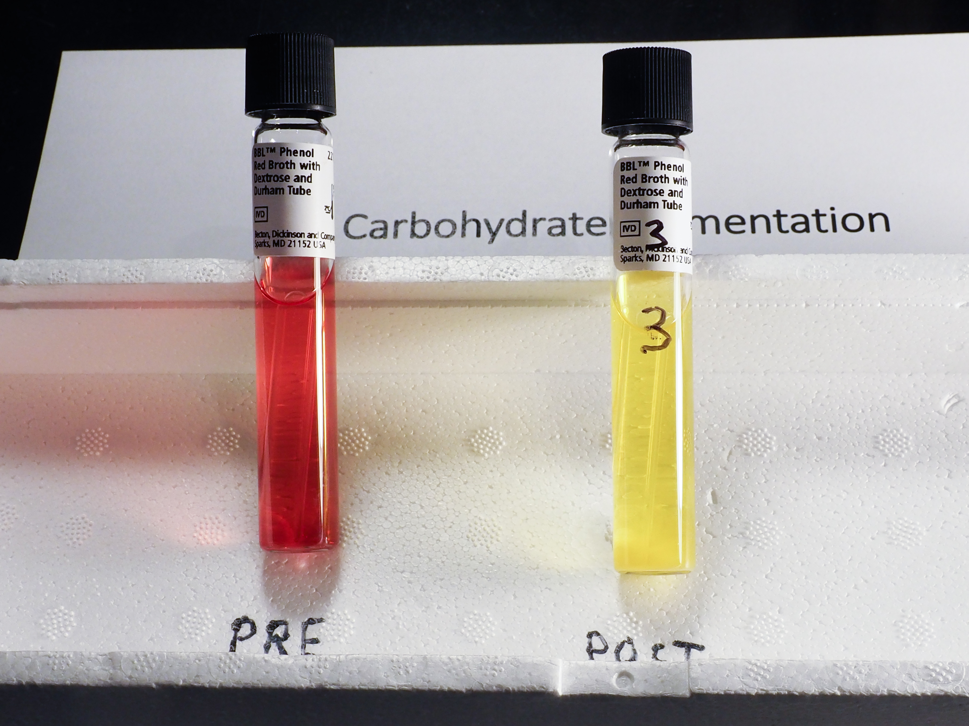
Unknown #3

Slide 14
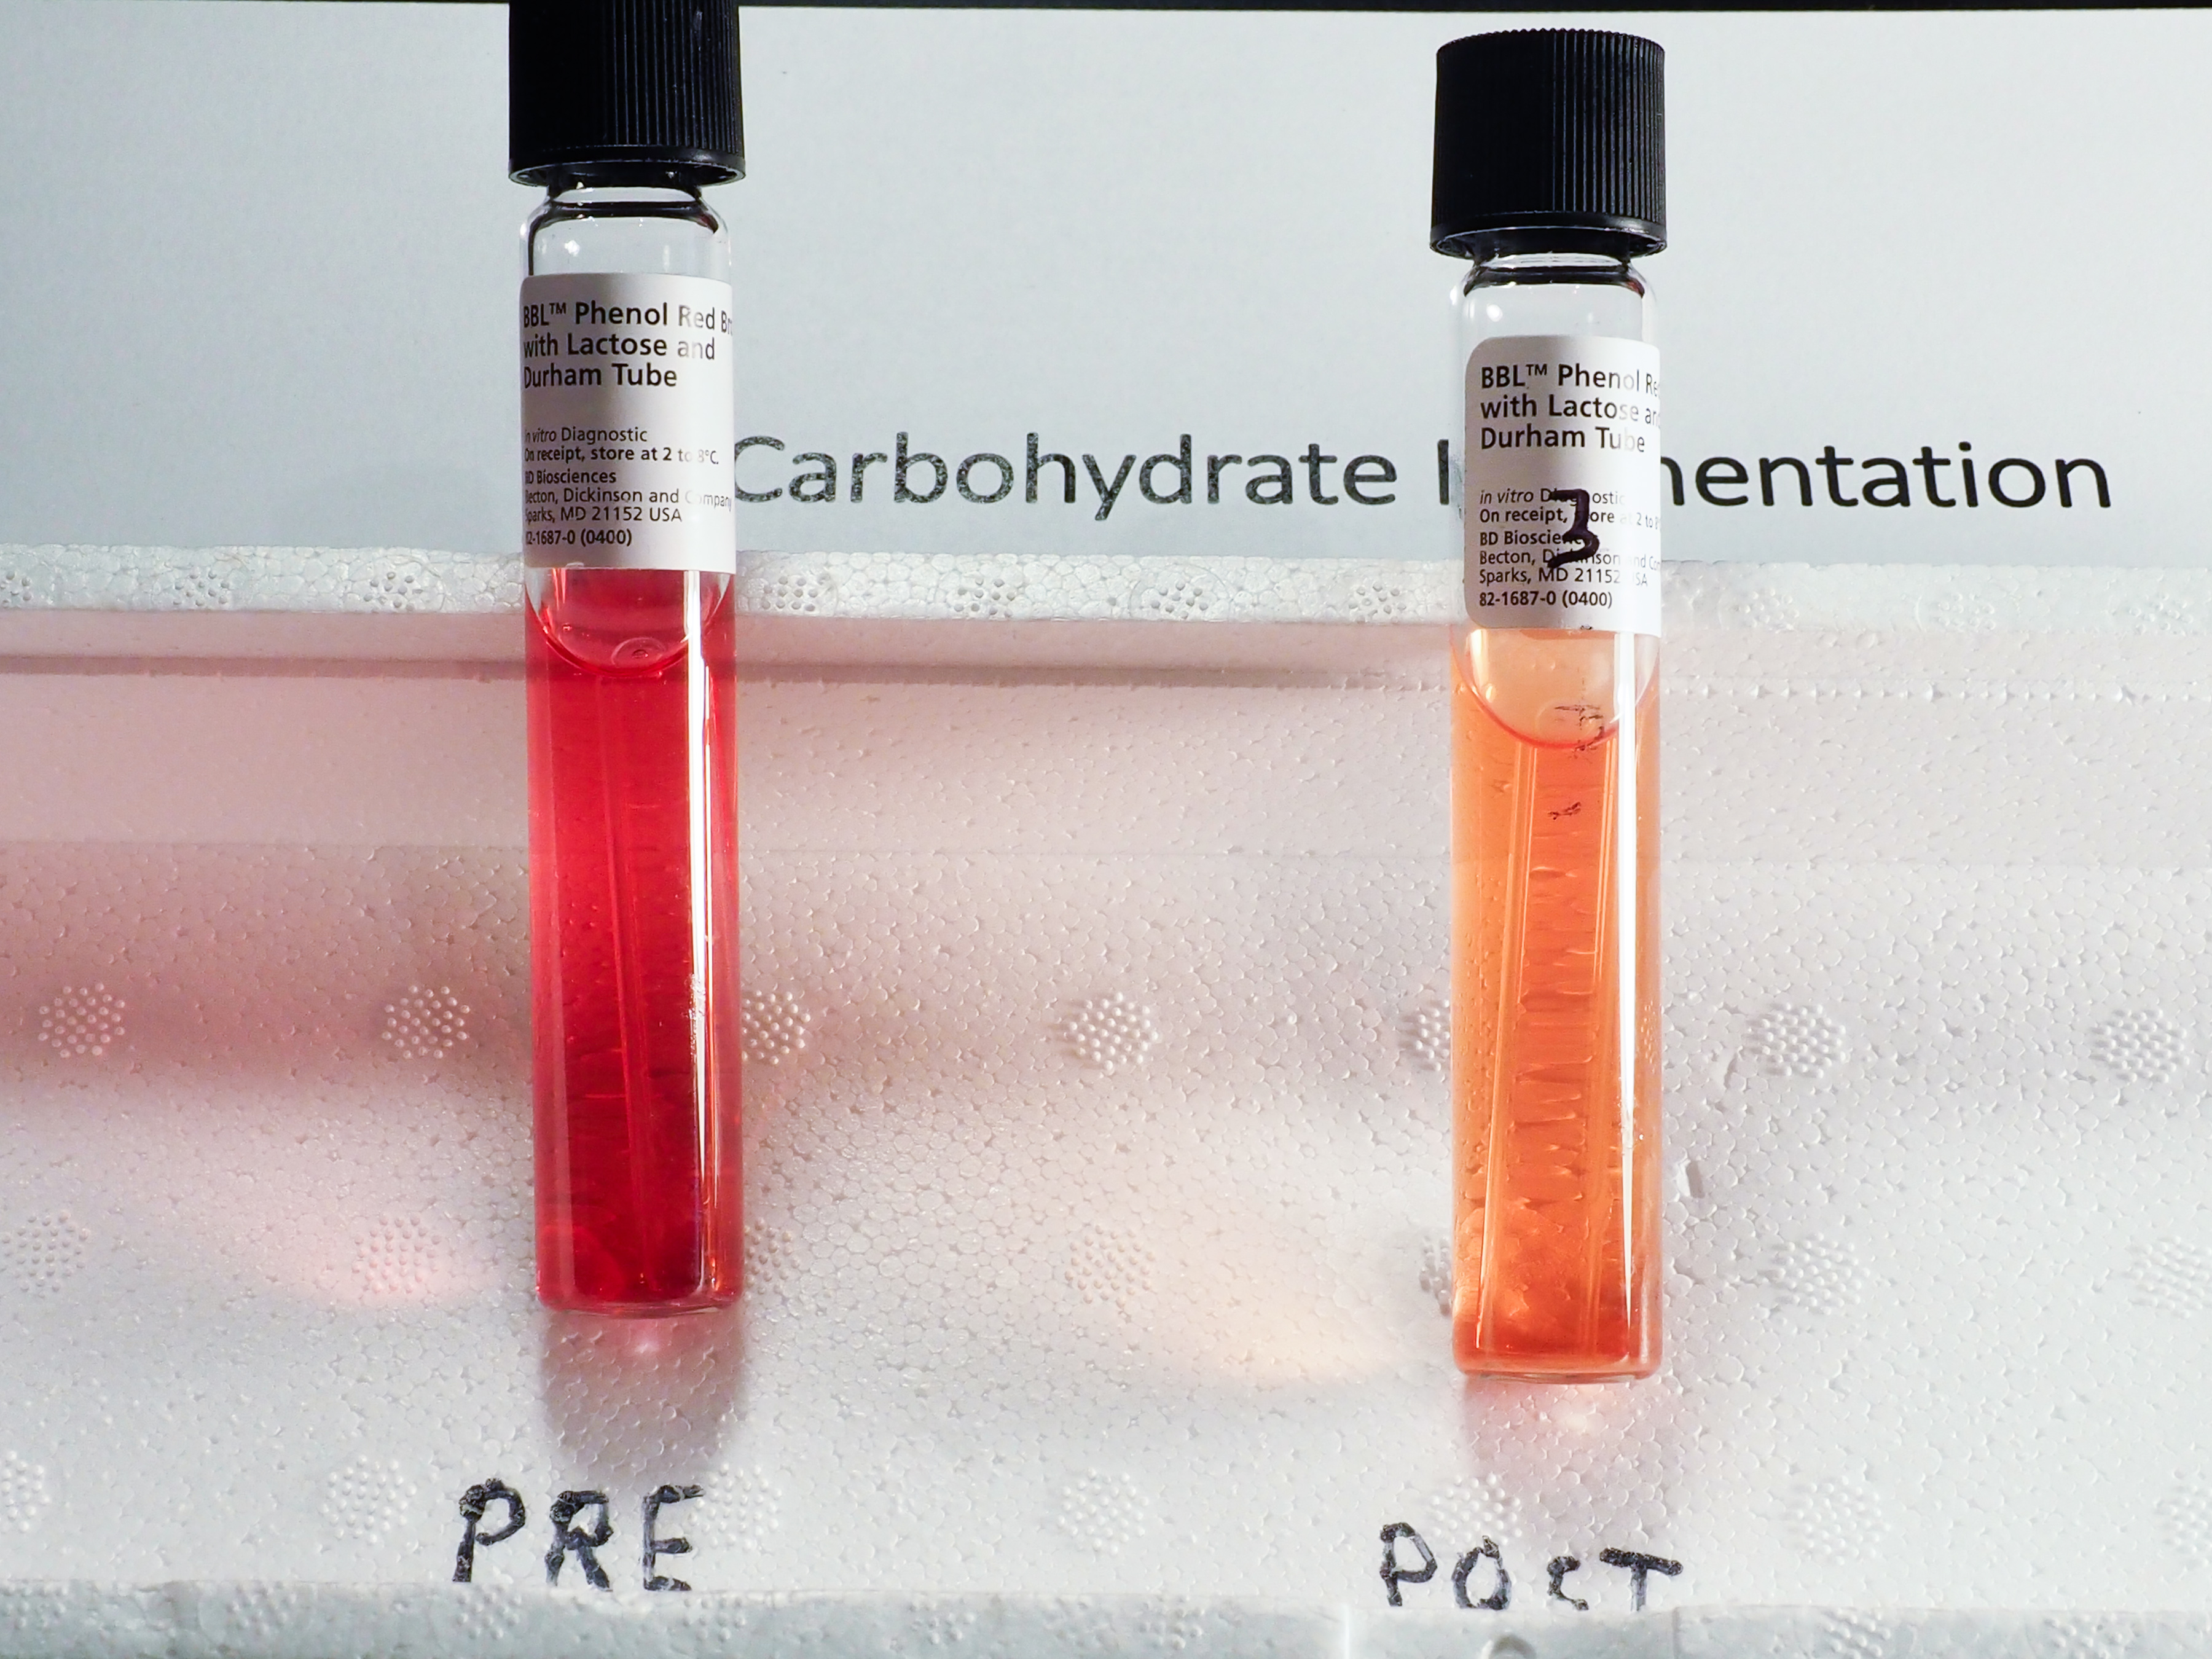
Unknown #3

Slide 15
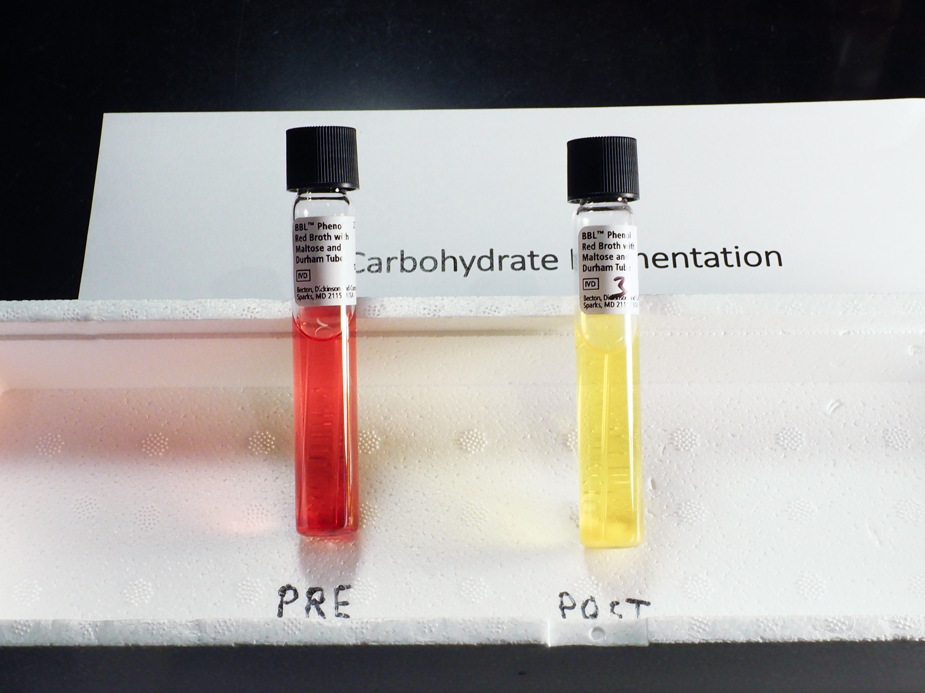
Unknown #3

Slide 16
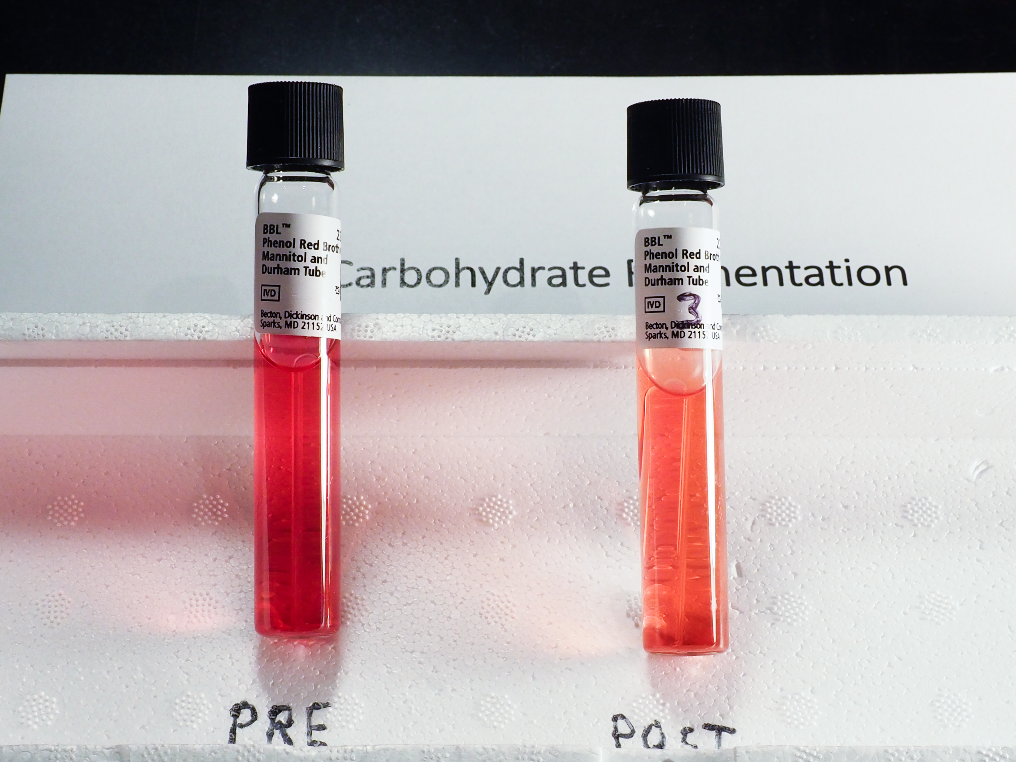
Unknown #3

Slide 17
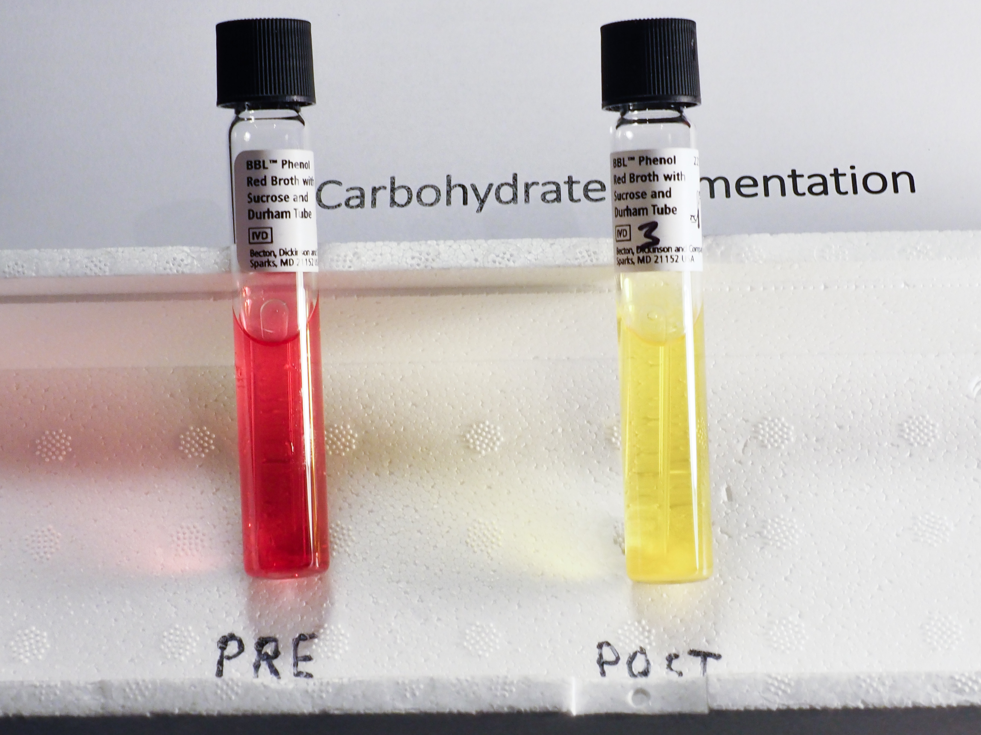
Unknown #3

Slide 18
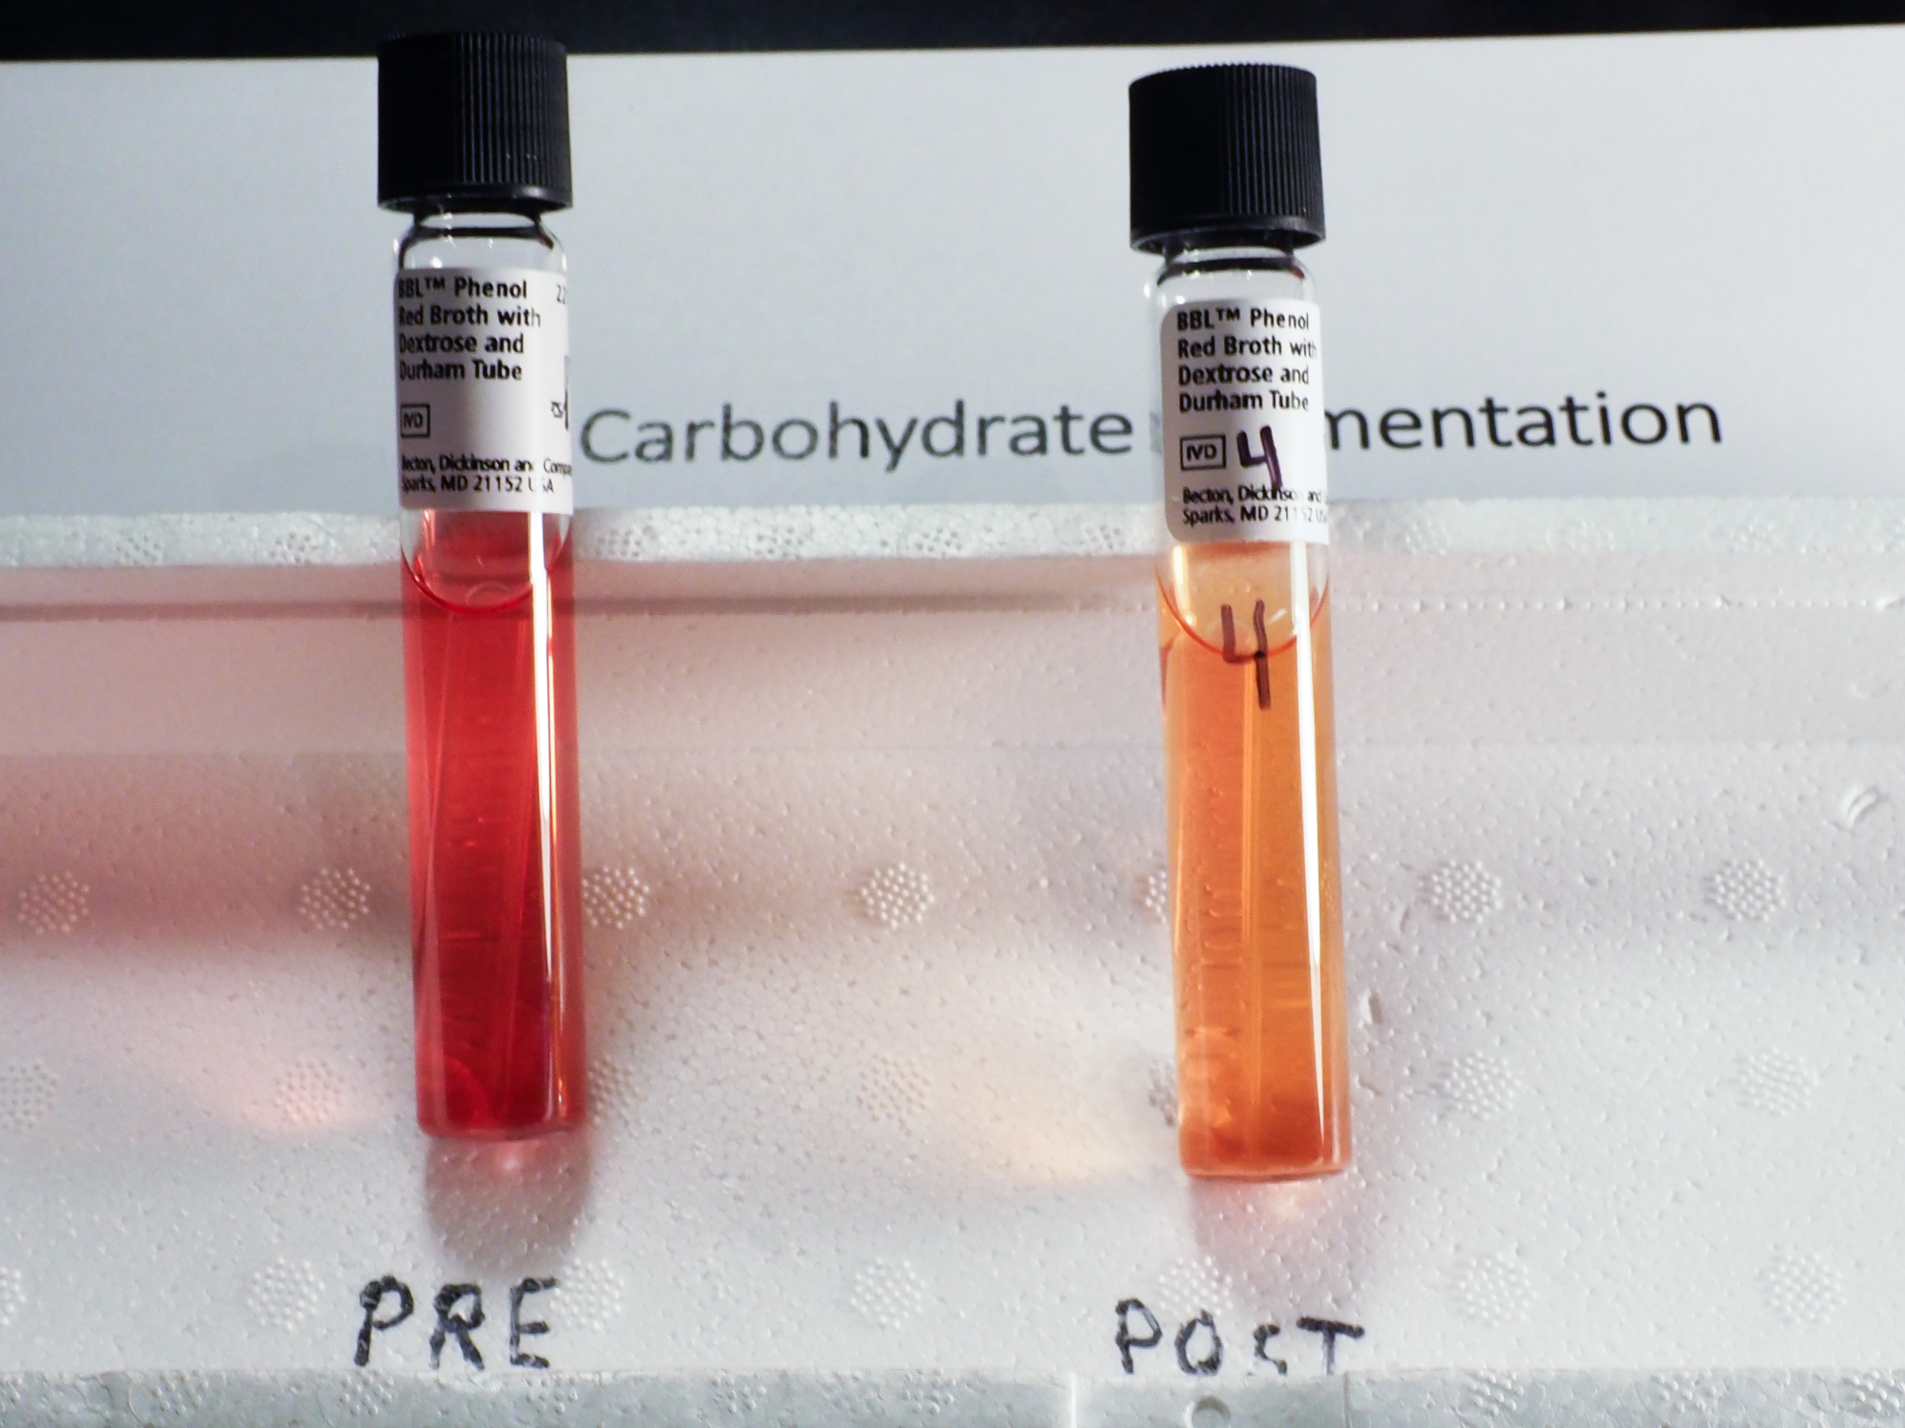
Unknown #4

Slide 19
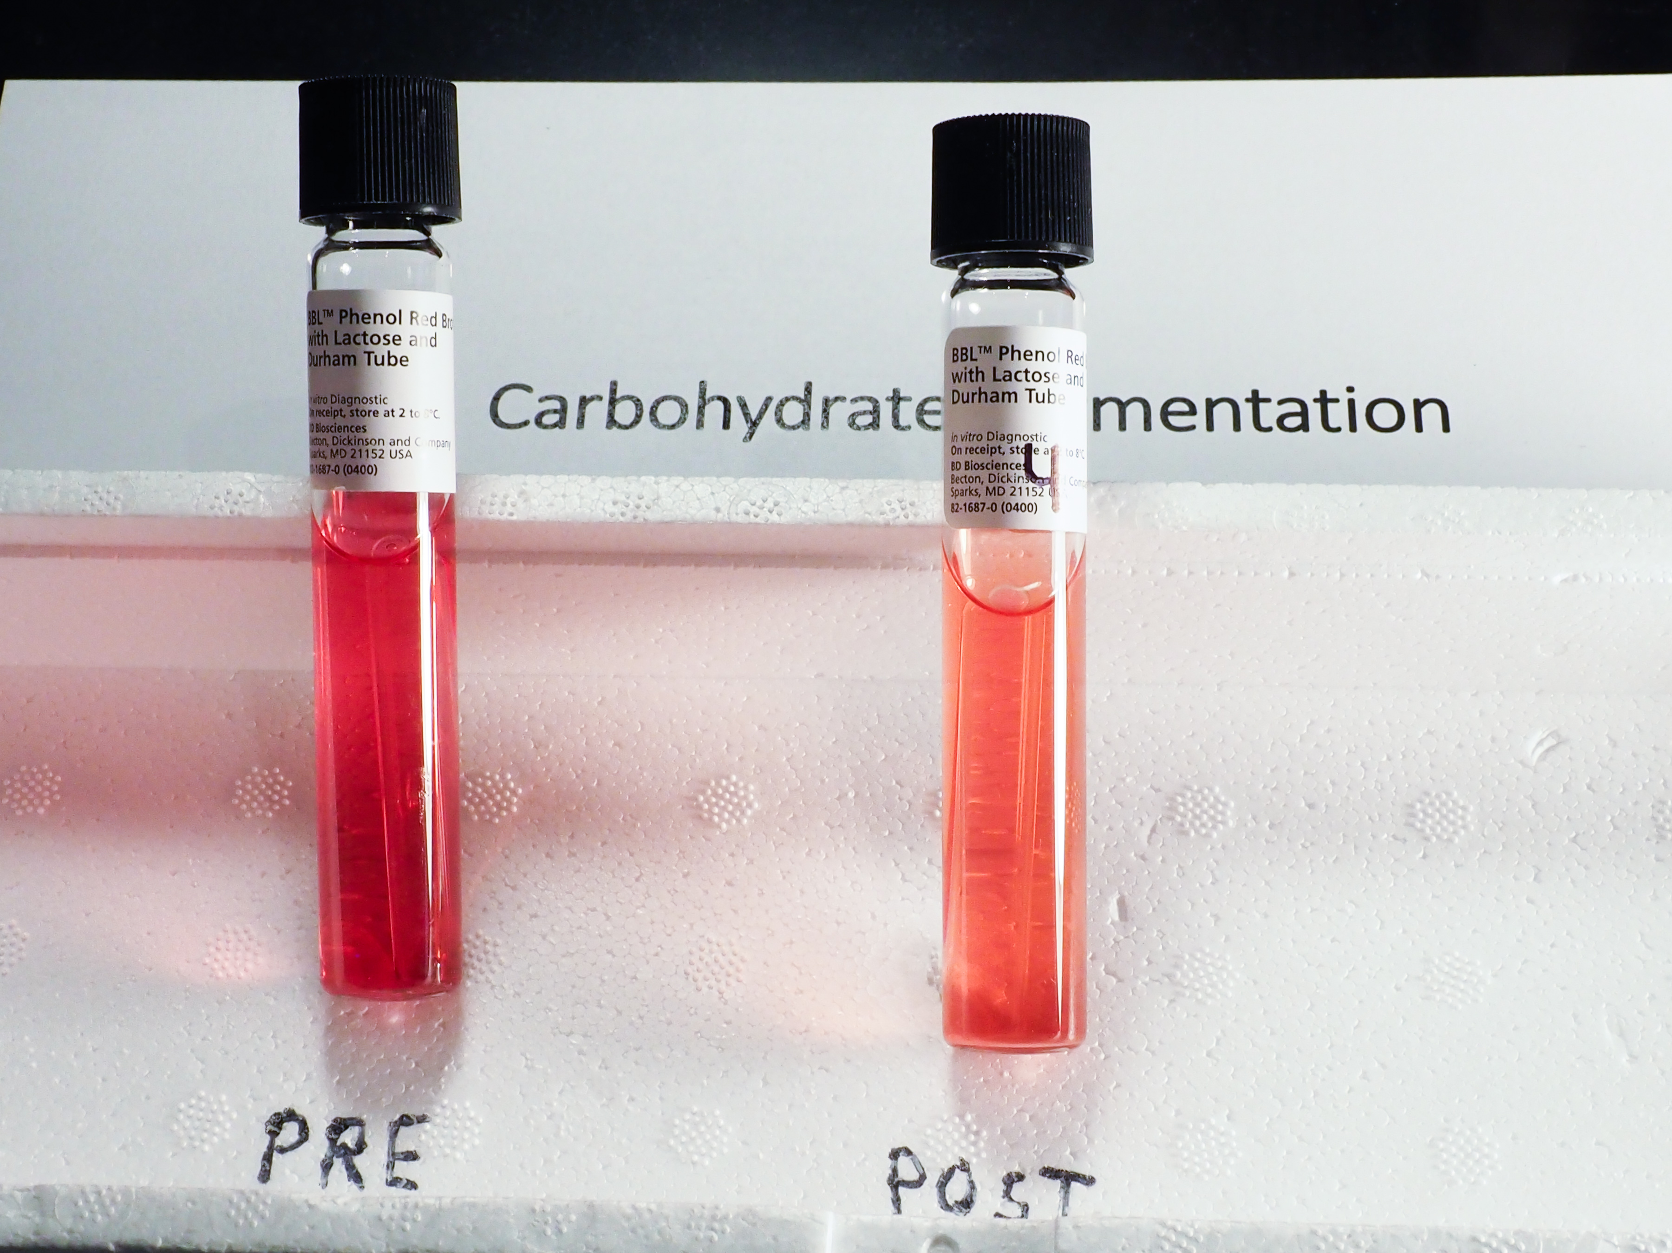
Unknown #4

Slide 20
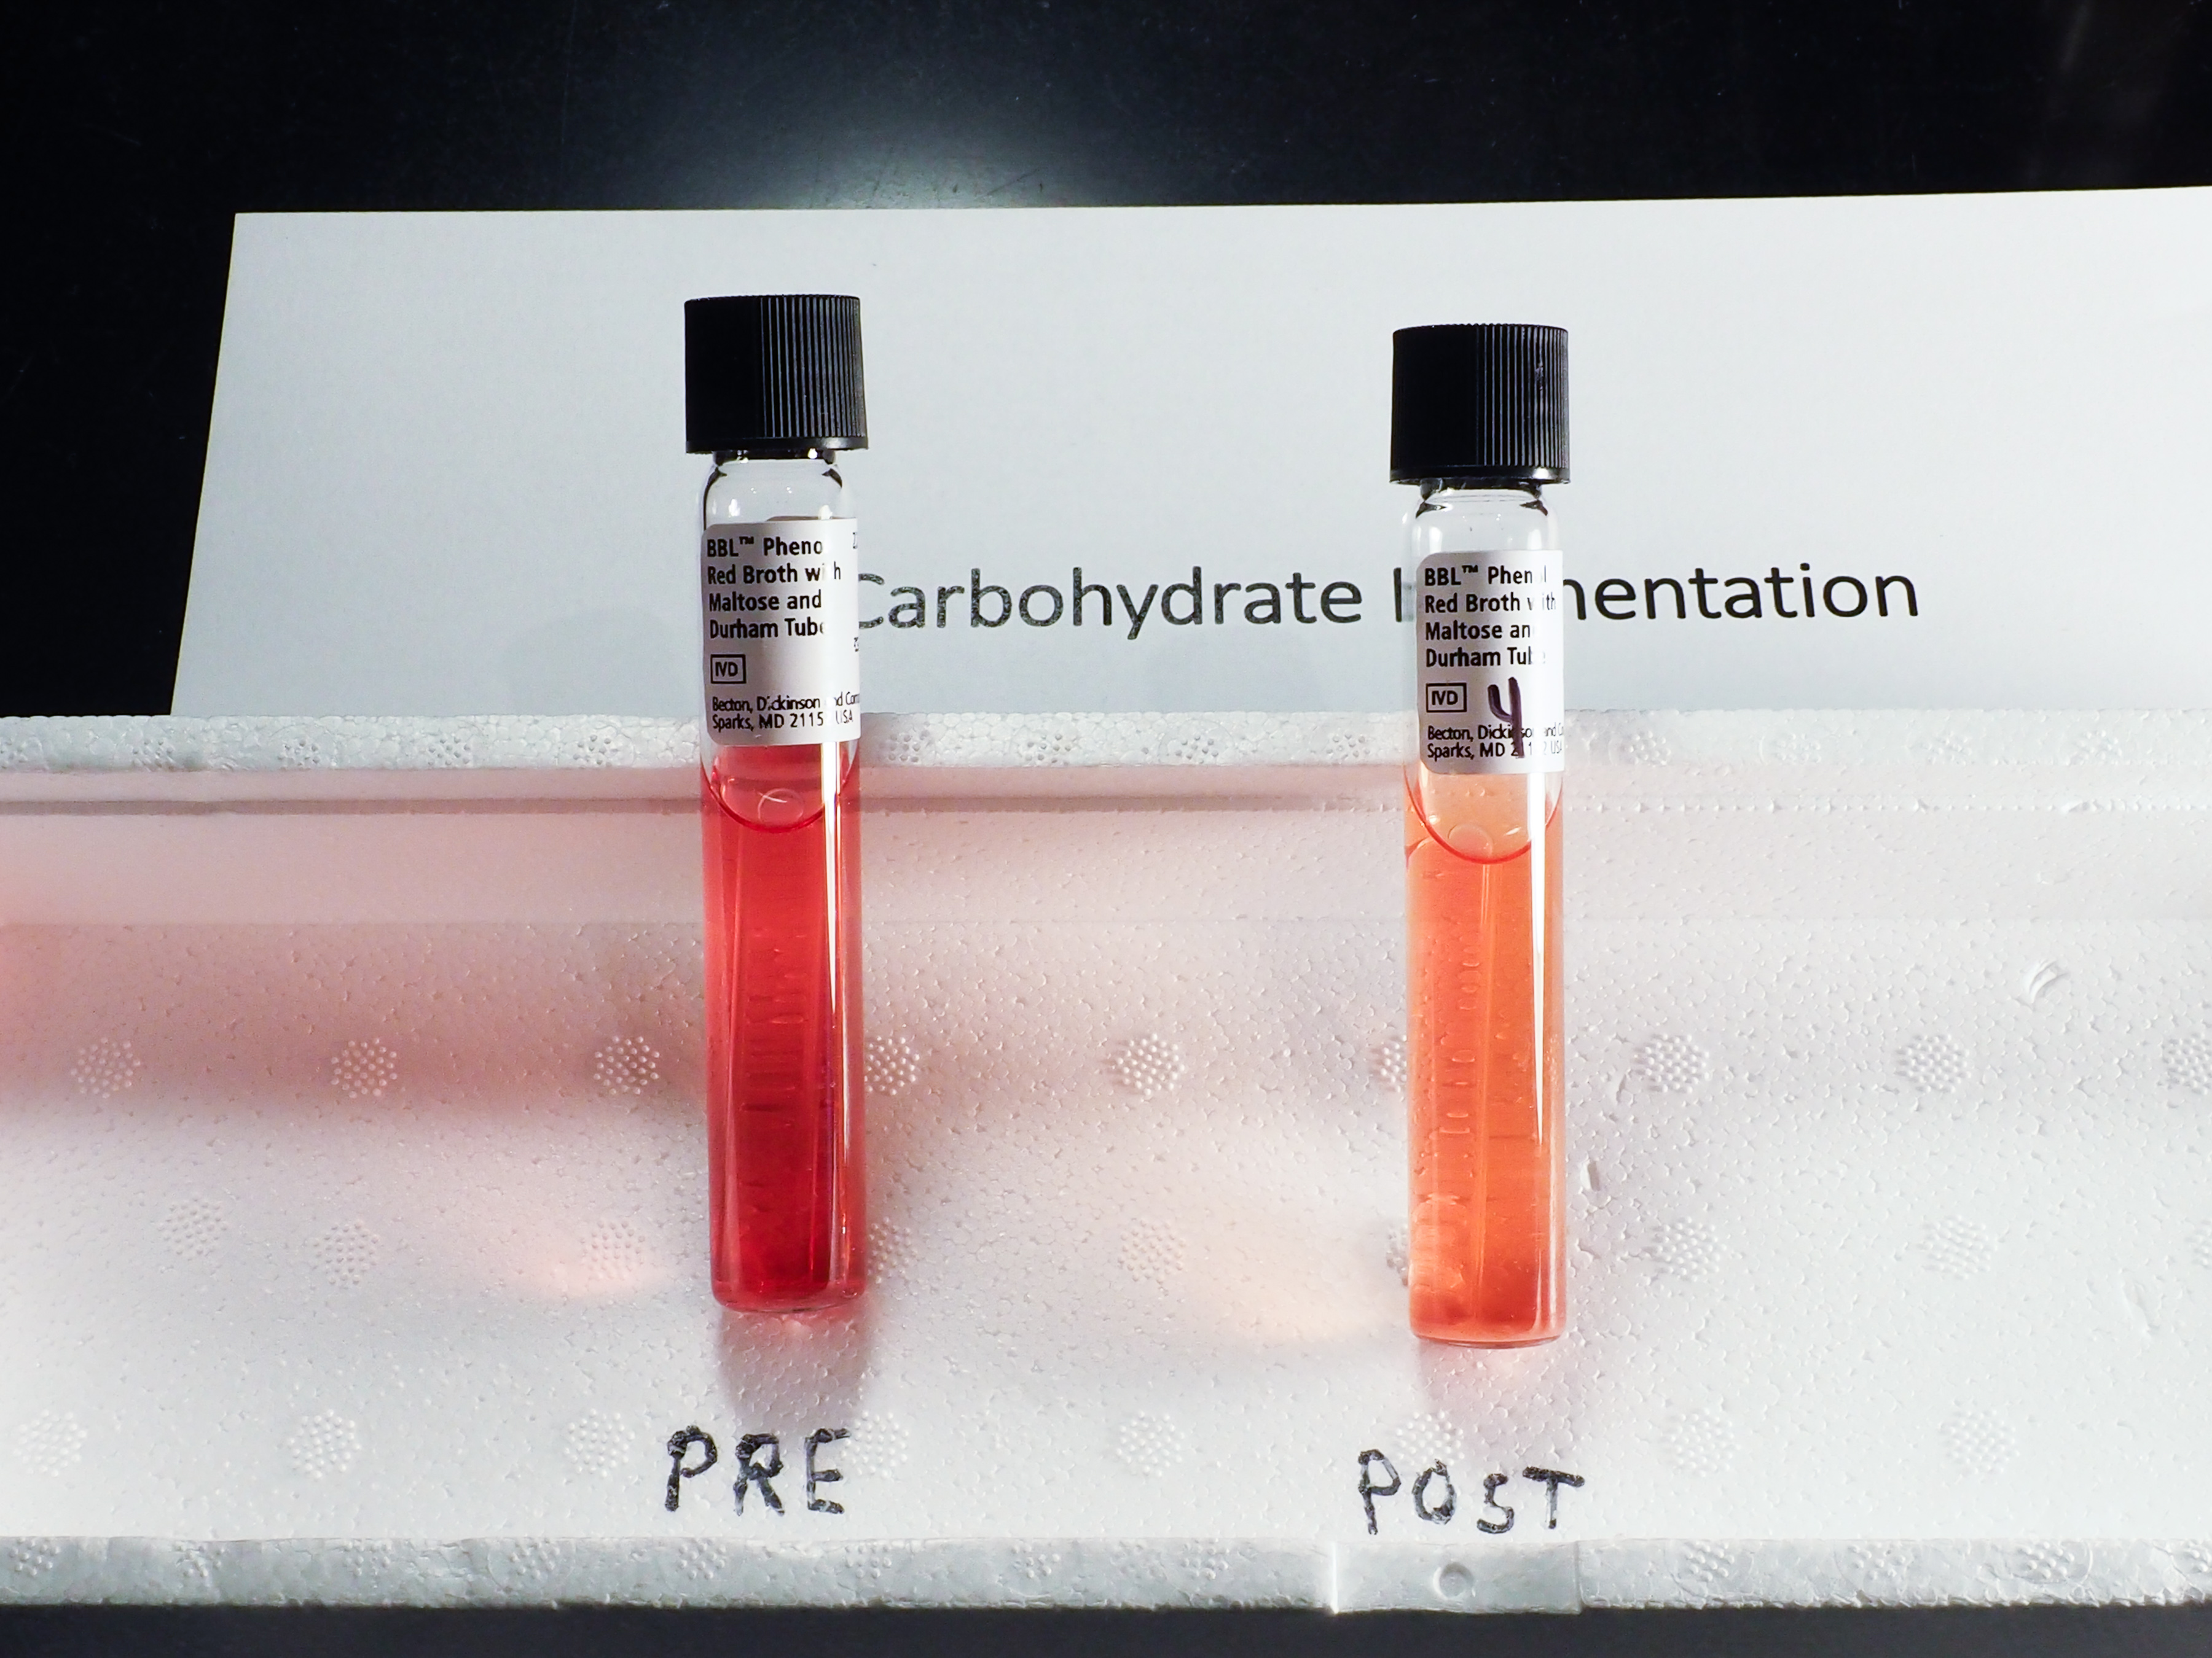
Unknown #4

Slide 21
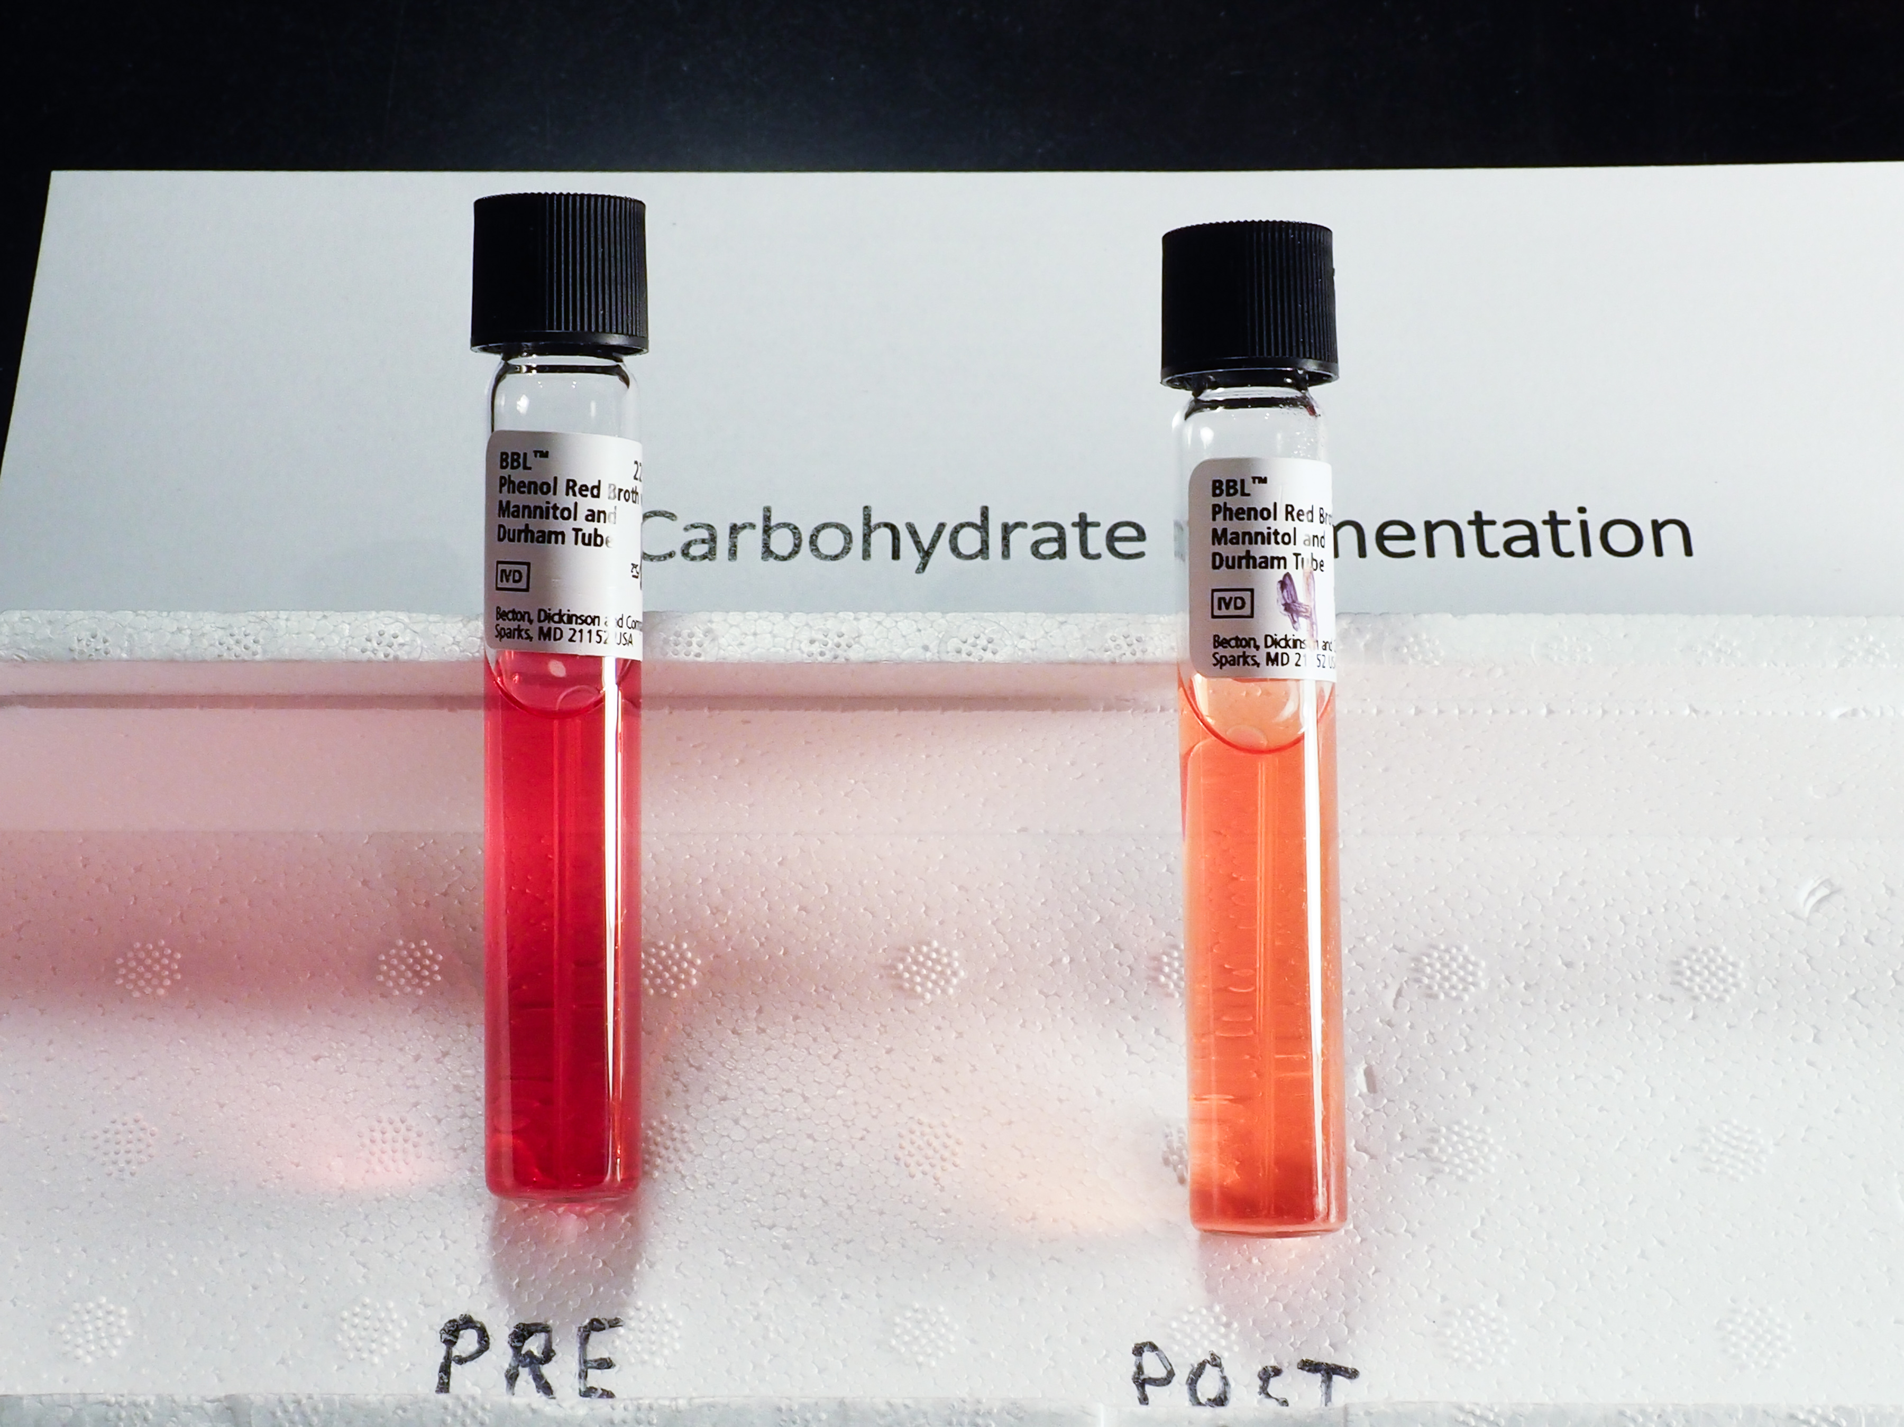
Unknown #4

Slide 22
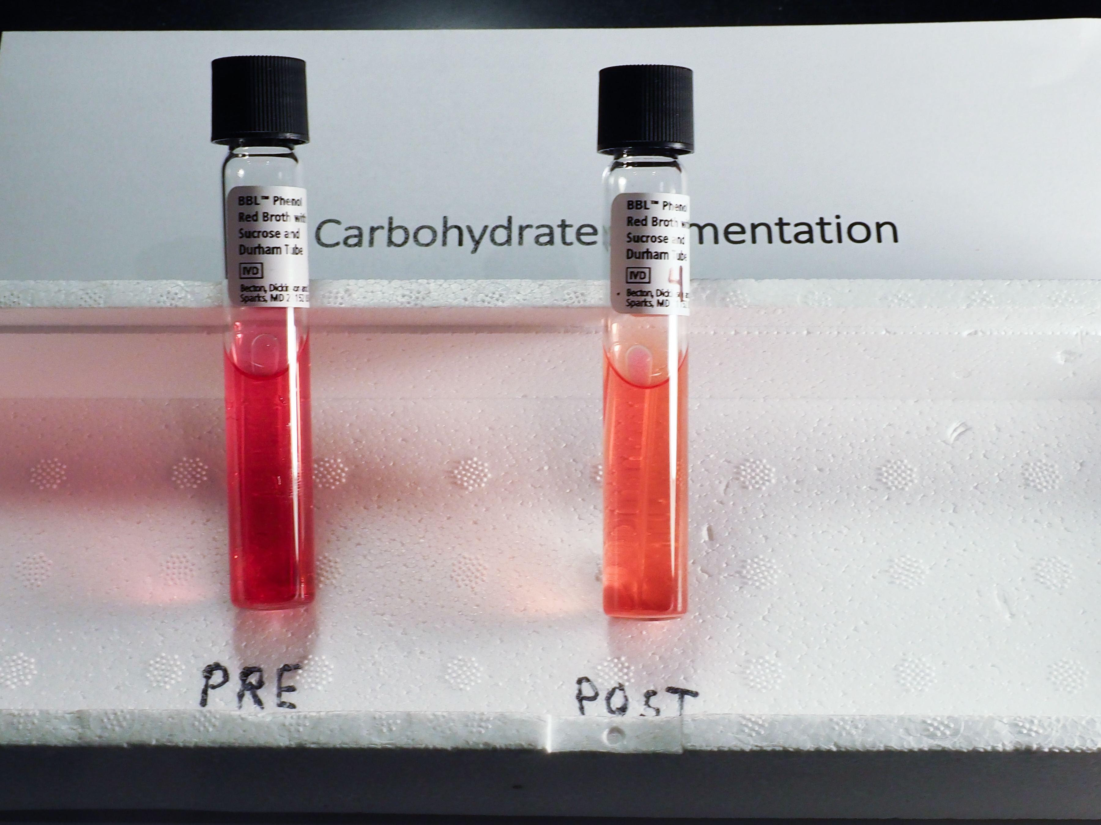
Unknown #4

Slide 23
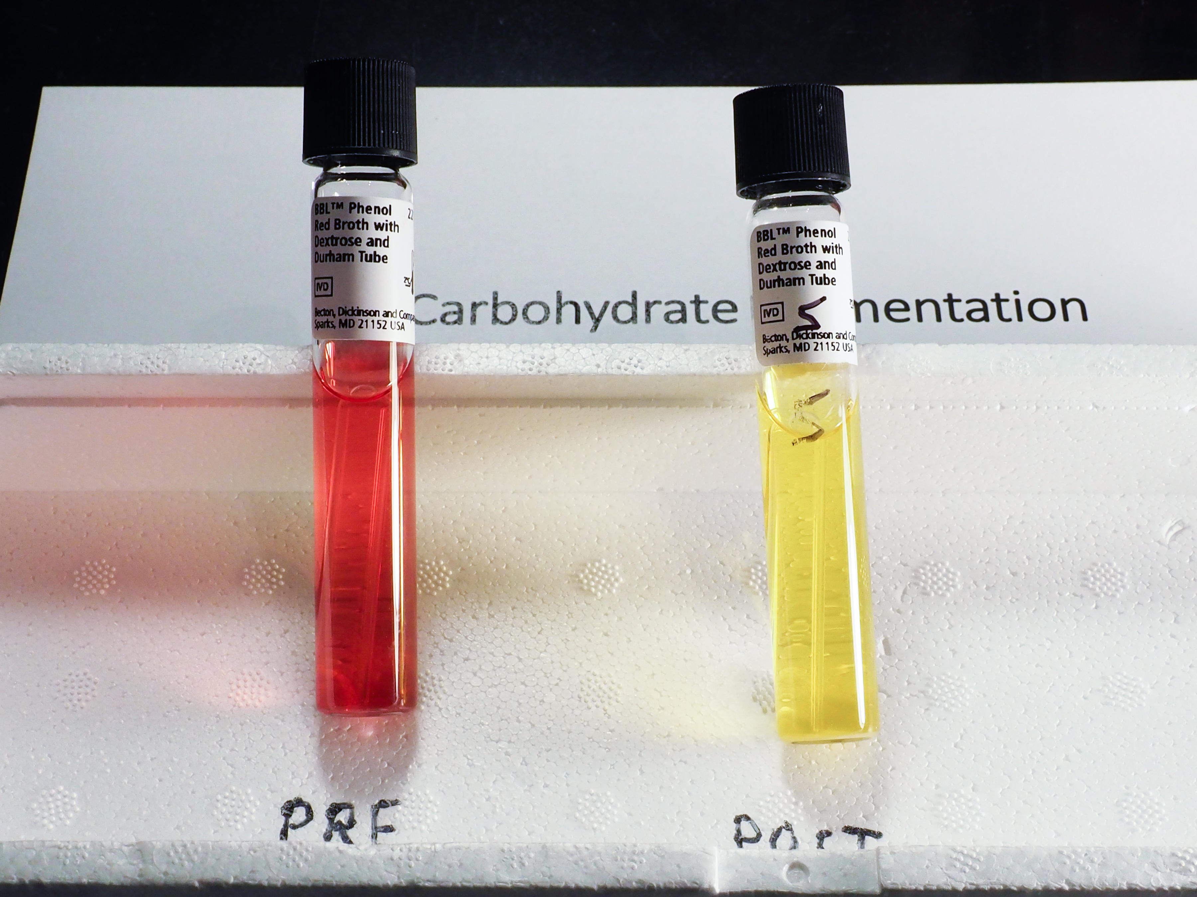
Unknown #5

Slide 24
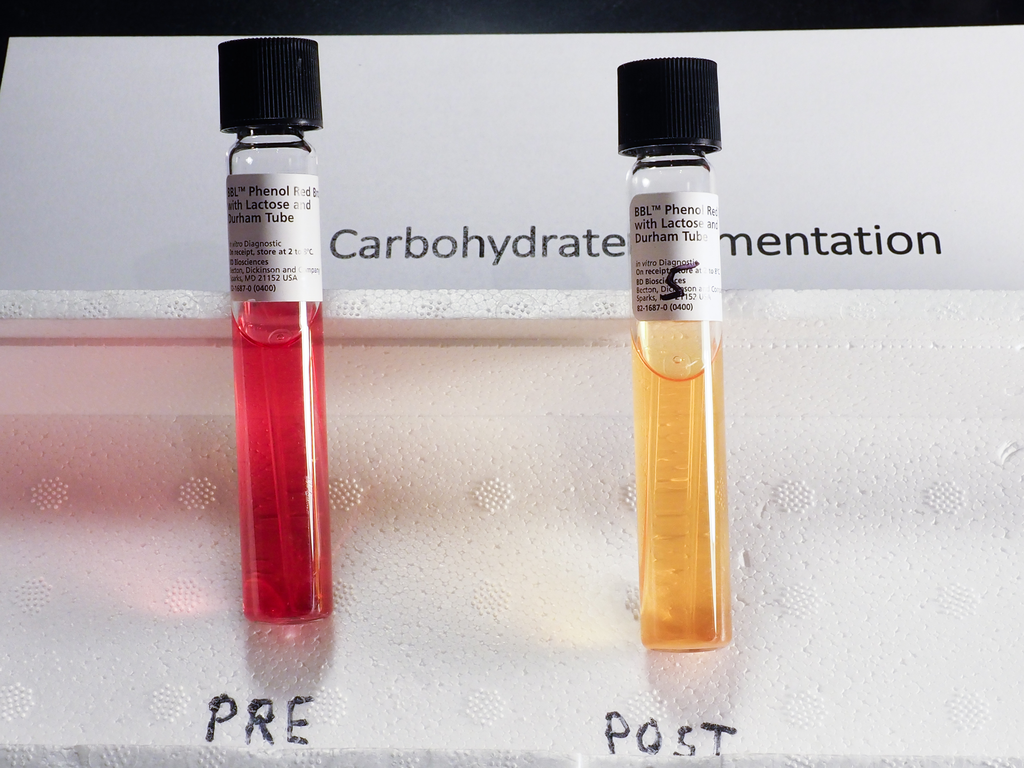
Unknown #5

Slide 25
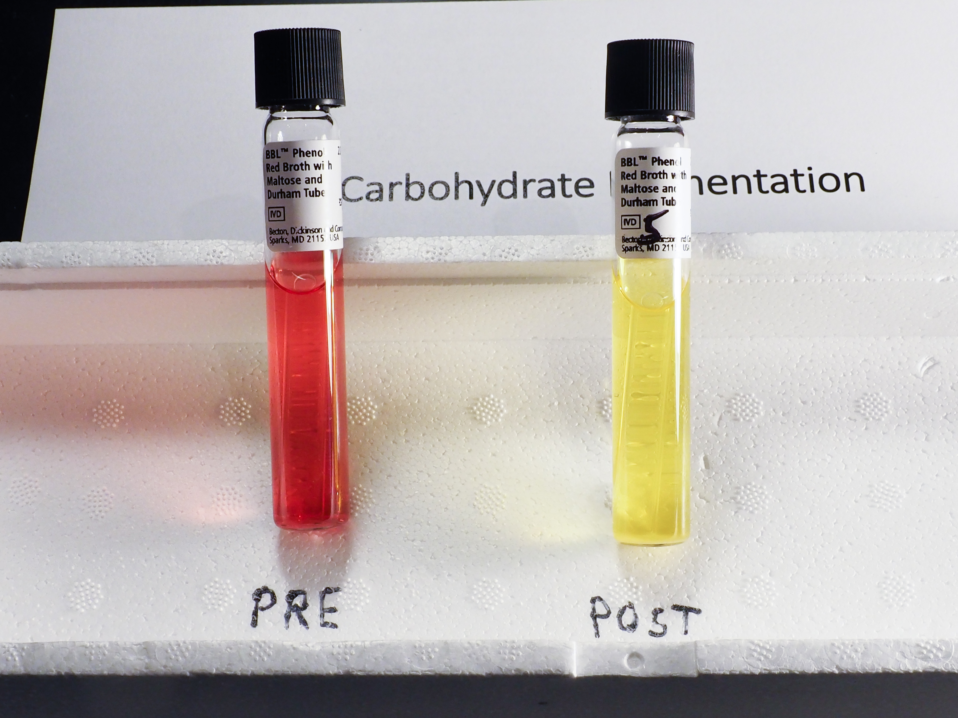
Unknown #5

Slide 26
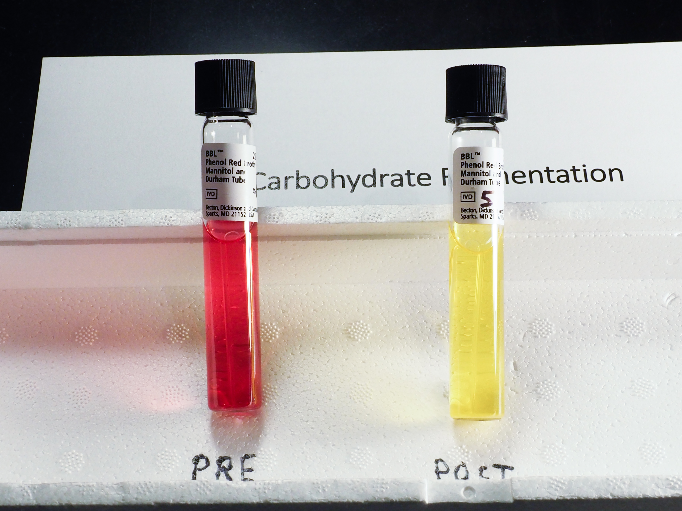
Unknown #5

Slide 27
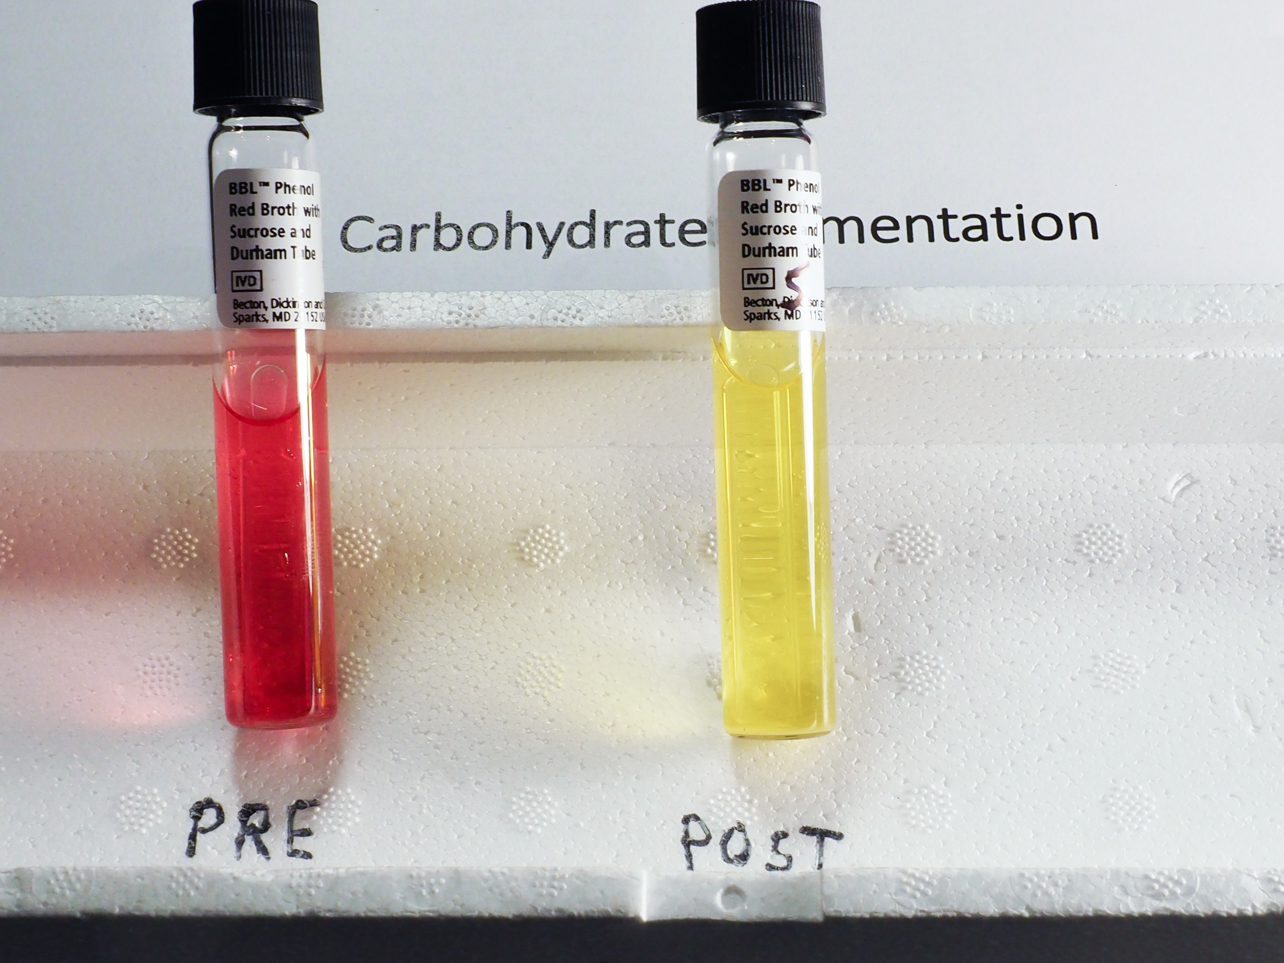
Unknown #5

Slide 28
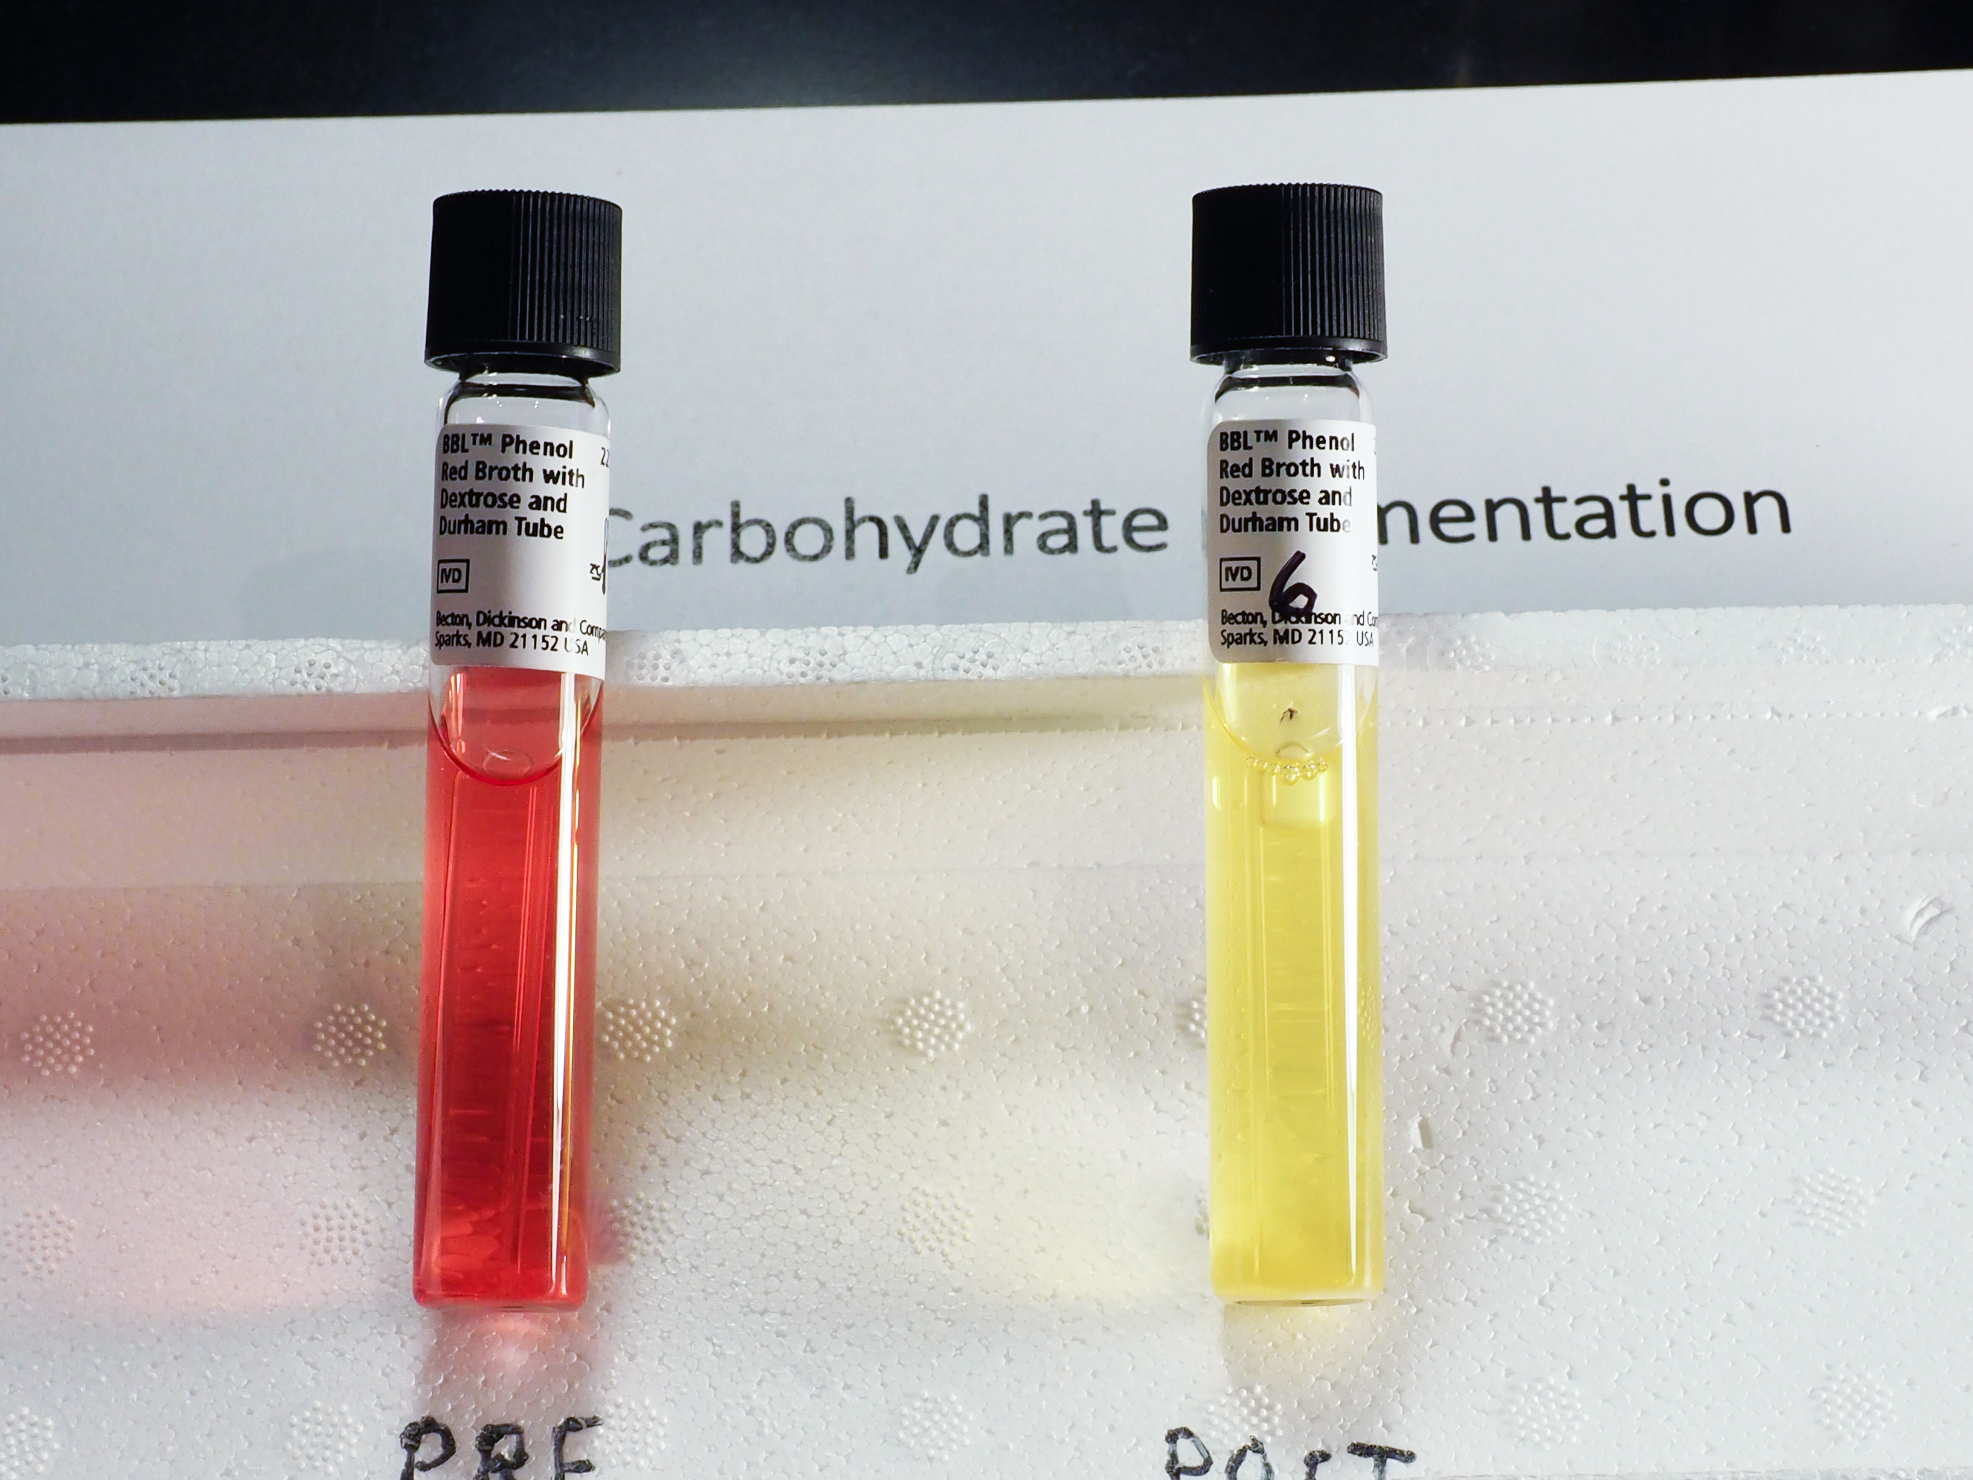
Unknown #6

Slide 29
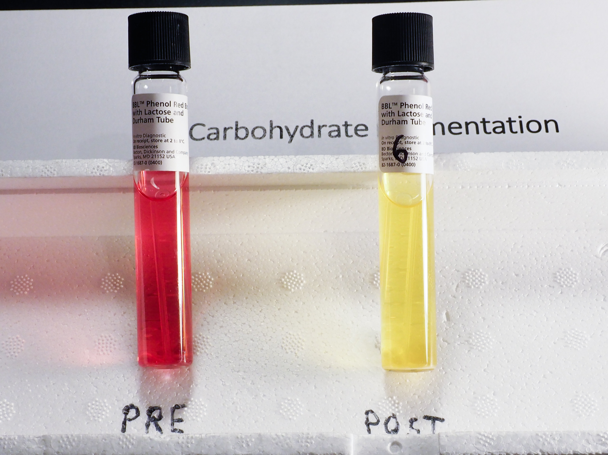
Unknown #6

Slide 30
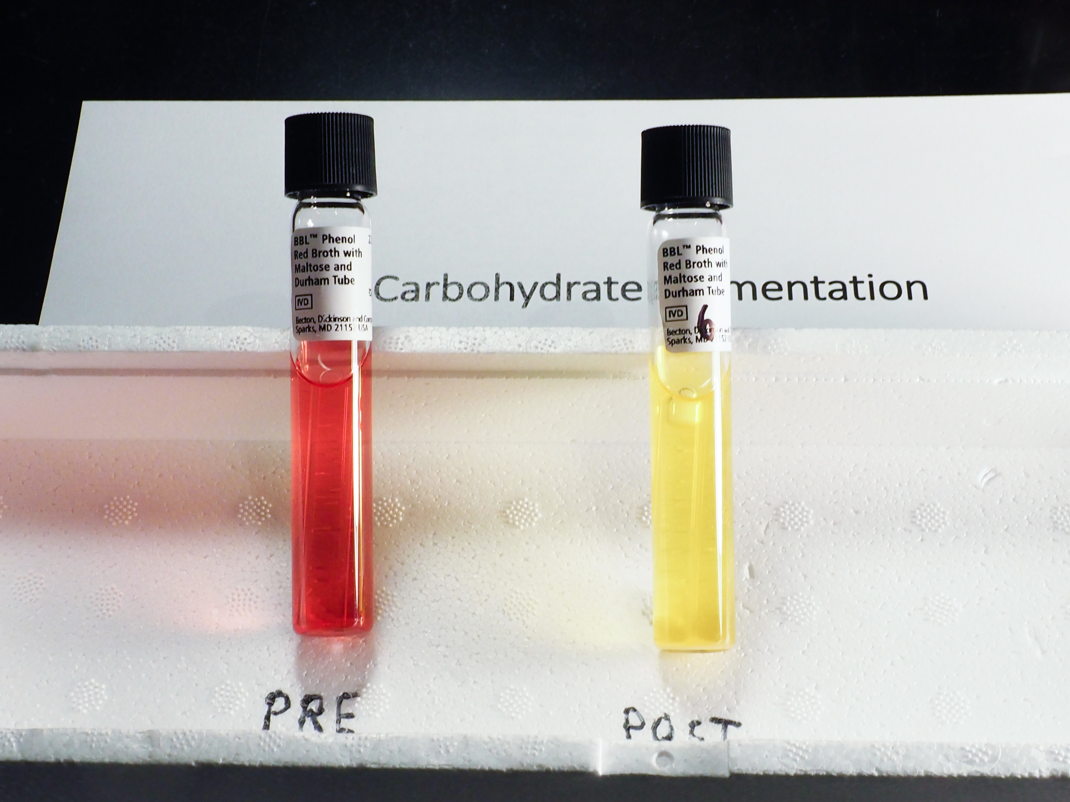
Unknown #6

Slide 31
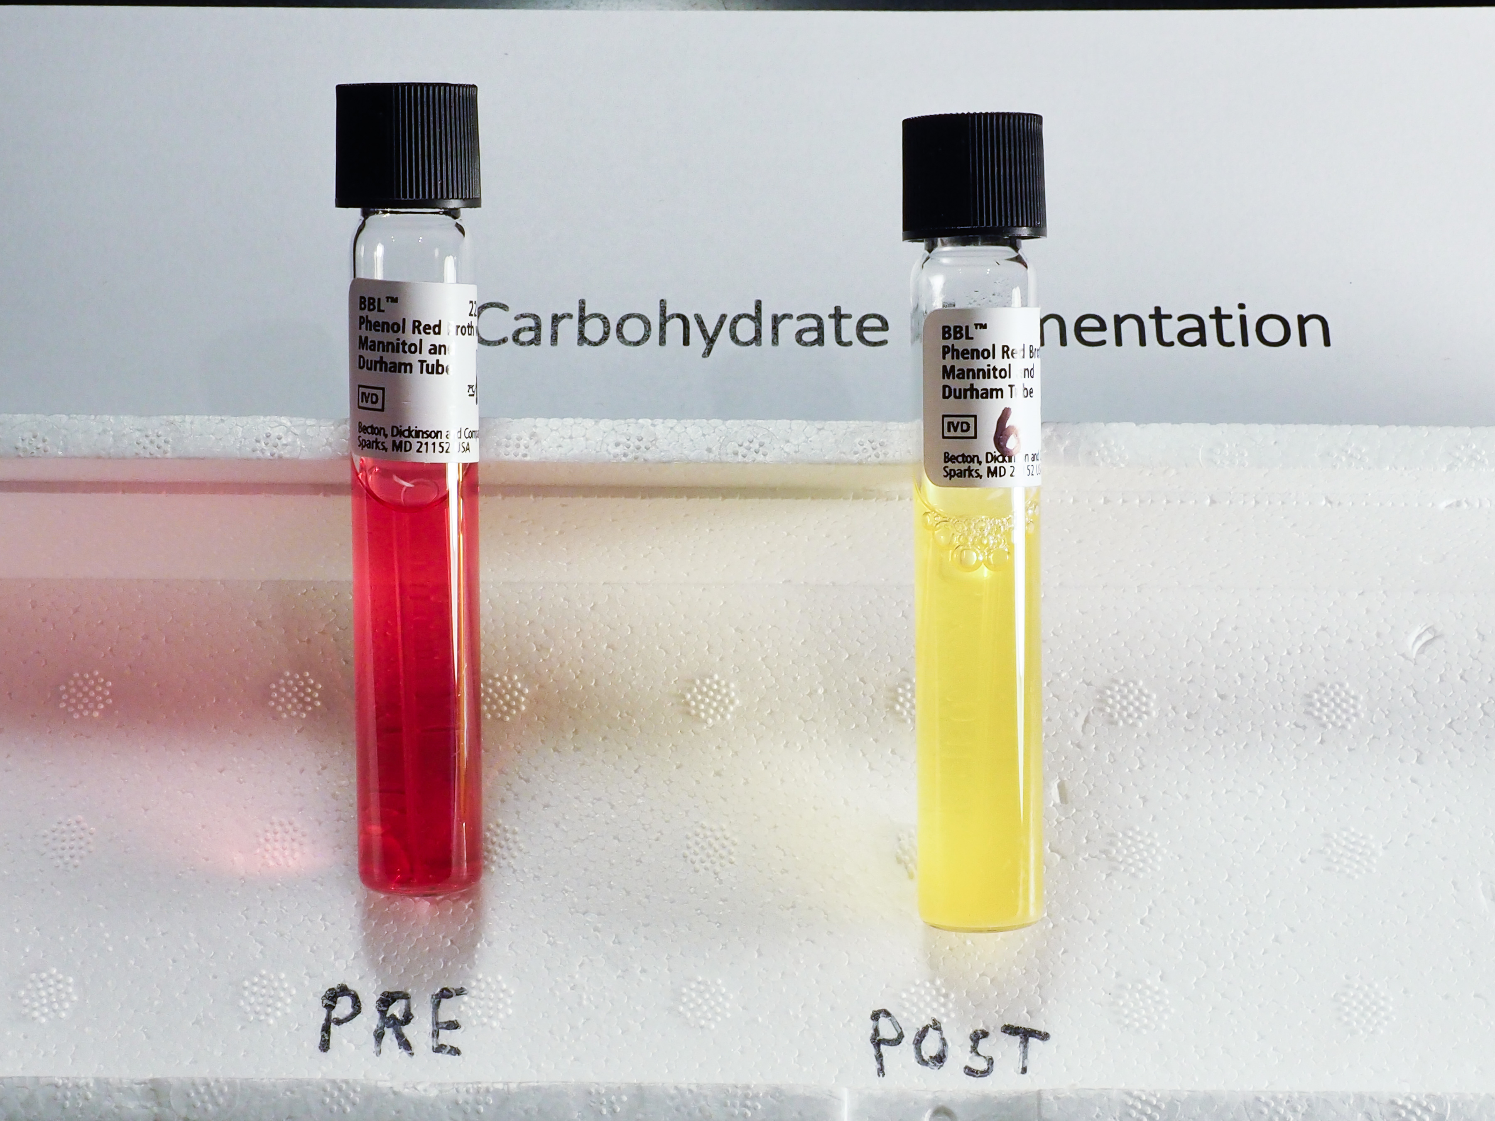
Unknown #6

Slide 32
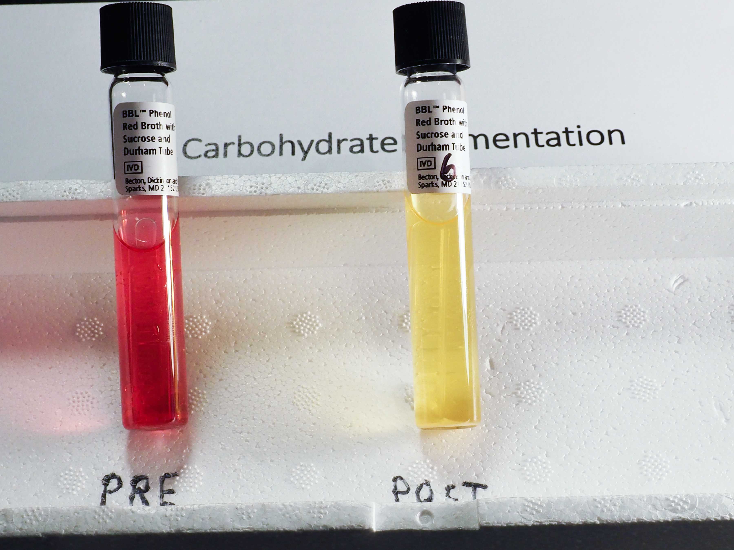
Unknown #6

